Slide 1
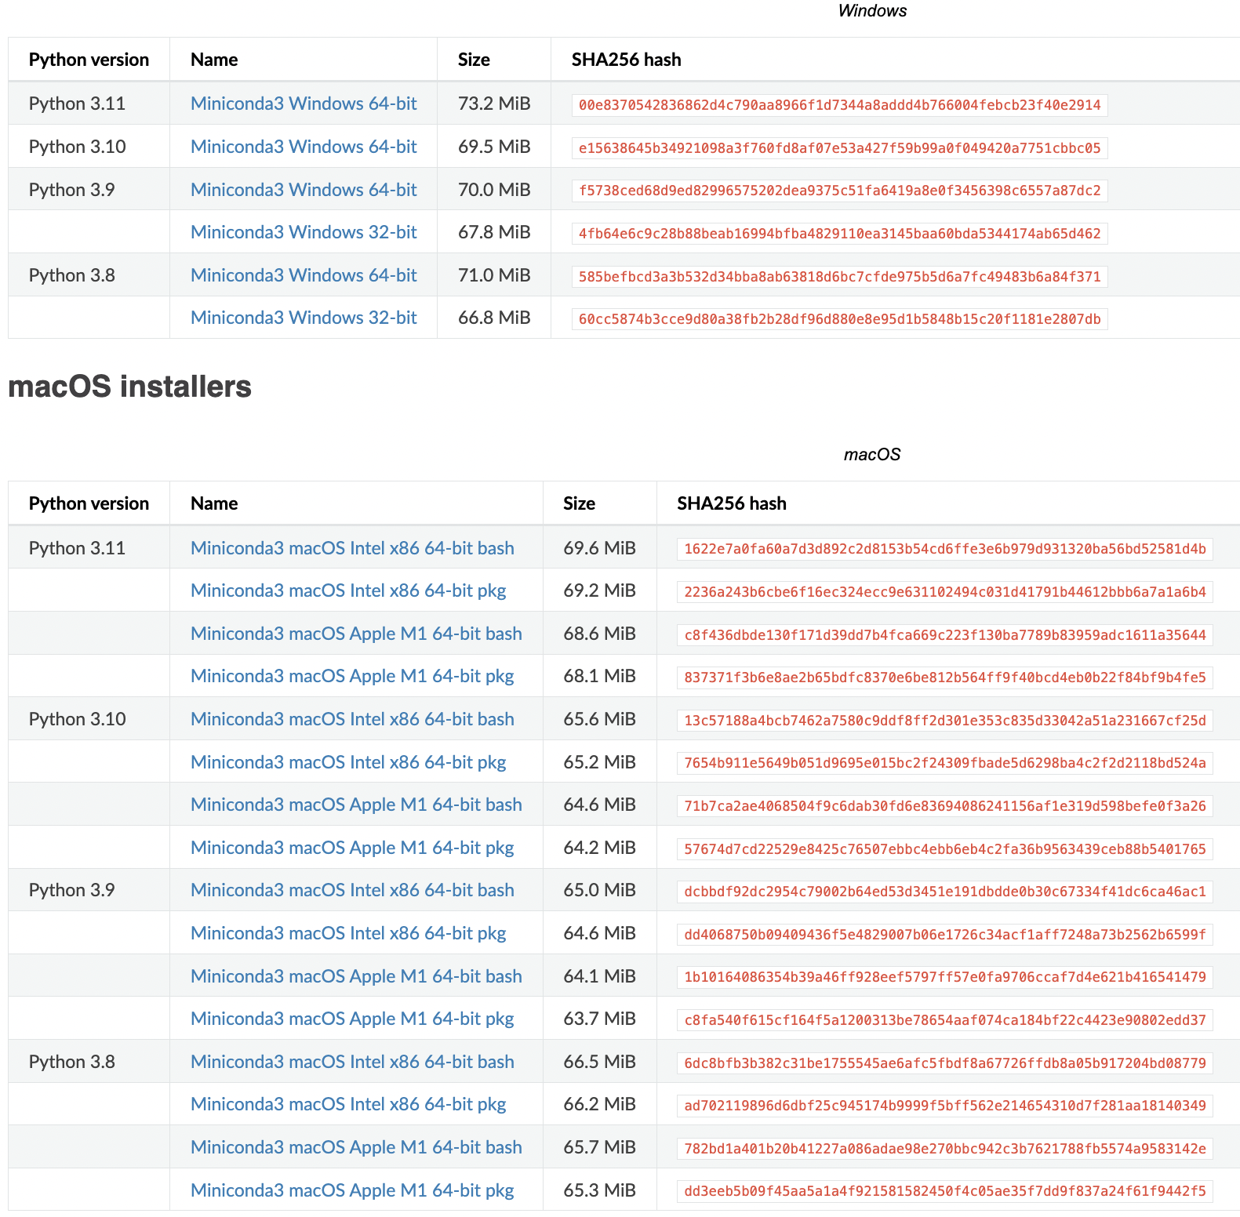
Step1: Please download the required files from dropbox.
Windows installers
Step2: Please install R libraries in Rstudio
options(timeout = 600000000)
install.packages("BiocManager")
BiocManager::install("ComplexHeatmap")
BiocManager::install("BiocNeighbors")
BiocManager::install("BiocGenerics")
BiocManager::install("Biobase")
install.packages("hdf5r")
install.packages("dplyr")
install.packages('Seurat')
install.packages("ggplot2")
install.packages("remotes")
install.packages("anndata")
install.packages("cowplot")
install.packages("devtools")
devtools::install_github("thomasp85/patchwork")
devtools::install_github('satijalab/seurat-data')
devtools::install_github("dmcable/spacexr", build_vignettes = FALSE)
remotes::install_github("mojaveazure/seurat-disk")
remotes::install_github("sqjin/CellChat")
remotes::install_github("jbergenstrahle/STUtility")
For Windows 64-bit
macOS installers
For Apple Intel
For Apple M1
Step4: Please create a conda environment using Anaconda Prompt on windows or terminal on macOS.
$cd {PATH_TO_2023_KOGO_summer_workshop_data}
$conda env create -f environment.yml
$python -m pip install --upgrade pip
$python -m pip install jupyter
$conda activate squidpy
$conda install -c anaconda ipykernel
$python -m ipykernel install --user --name squidpy
$conda deactivate
$jupyter notebook
Step3: Please install Conda. https://docs.conda.io/en/latest/miniconda.html

Slide 2


Spatial Transcriptome with R programming
제 17회 통계유전학워크샵
2023. 7. 19. Wed
Choi Lab
Korea University College of Medicine

Slide 3
Welcome to Spatial Transcriptomic session
R/Python script, objects, power point slides and can be downloaded here:
https://github.com/JuhyeonHong/2023_KOGO_summer_workshop/tree/main
Steps | File name | Input/Output
chapter 4 visium data | KOGO_brain.rds | Chapter 4 input
chapter 4 single cell reference (before pre-process) | KOGO_sc_allen_cortex.rds | chapter 4, 5 input
chapter 4 single cell reference (after pre-process) | KOGO_sc_allen_cortex_processed.rds | chapter 4, 5 input
chapter 4 processed visium data | KOGO_visium_brain_processed.rds | chapter 4 output
chapter 4 processed visium data | KOGO_visium_cortex_processed.rds | chapter 4 output
chapter 5 spacexr RCTD doublet mode result | KOGO_visium_brain_RCTD.csv | chapter 5 output
chapter 5 spacexr RCTD annotated visium data | KOGO_visium_cortex_annotated.rds | chapter 6, 7 input
chapter 6 conda environment info | environment.yml | chapter 6 python environment
chapter 6 anndata | KOGO_visium_cortex_anndata.h5ad | chapter 6 input/output
chapter 6 jupyter notebook | KOGO_chapter6_neighborhood_analysis_of_cooccurrence_squidpy.ipynb | chapter 6 python script
chapter 7 visium json | KOGO_scalefactors_json.json | chapter 7 input
chapter 7 cellchat prop calculated object | KOGO_visium_cortex_prob_cellchat.rds | chapter 7 output
chapter 8 STUtility input folder | KOGO_visium_STUtility_input_files | chapter 8 input
chapter 8 STUtility object | KOGO_visium_cortex_STUtility.rds | chapter 8 output
Input files and python script highlighted with blue should be downloaded before starting analysis
Please make a directory for this analysis and save necessary objects at the directory
Set the directory before we start analysis

Slide 4
Table of Contents
Chapter 1 | What is R and python programming?
Chapter 2 | What is single cell RNA-seq and spatial transcriptomics?
Chapter 3 | What is Space Ranger?
Chapter 4 | Integrative analysis of spatial datasets - Seurat
Chapter 5 | Deconvolution analysis – SpaceXR
Chapter 6 | Neighborhood analysis of co-occurrence - Squidpy
Chapter 7 | Cell-cell interaction analysis - CellChat
Chapter 8 | Visualization of multi-feature blended spatial plot – STUtility
Chapter 9 | Summary
Chapter 10 | Q&A
Exercise
Github repository for the workshop :

Slide 5
What is R programming?
1

Slide 6



What is R and Why R?
R is used widely in biological research and provides a solid
platform for beginner scientific programmers.
It’s free and open-source.
Bioconductor uses the R statistical programming language and is open source and open development.
Modified from : https://datacarpentry.org/semester-biology/about/why-r/
https://www.bioconductor.org/

Slide 7
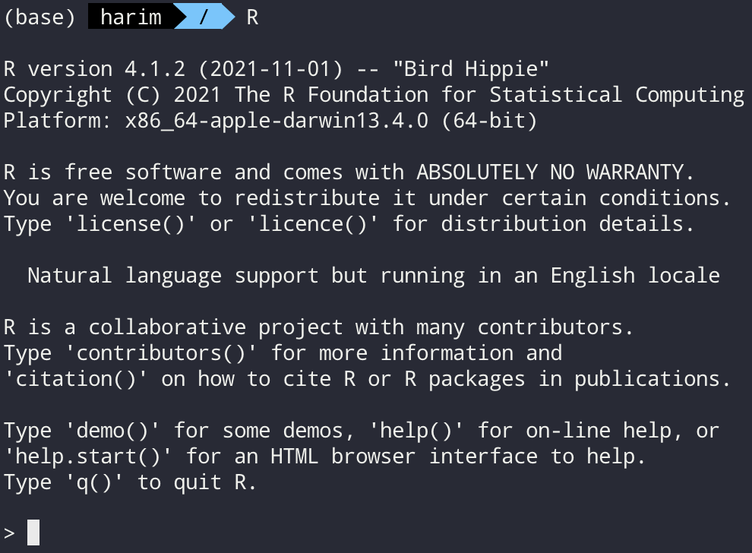
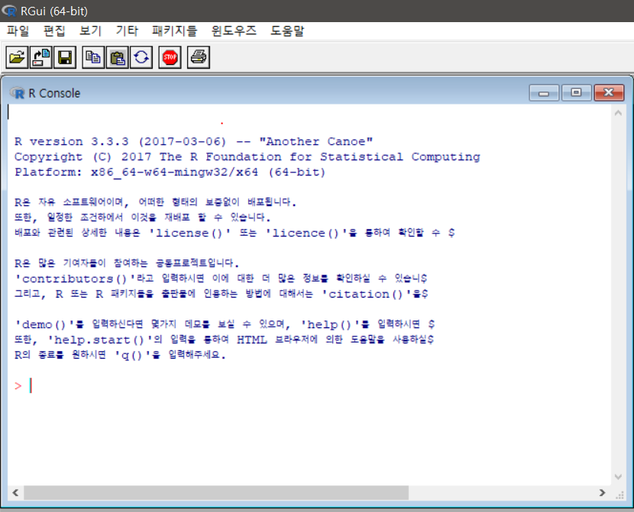
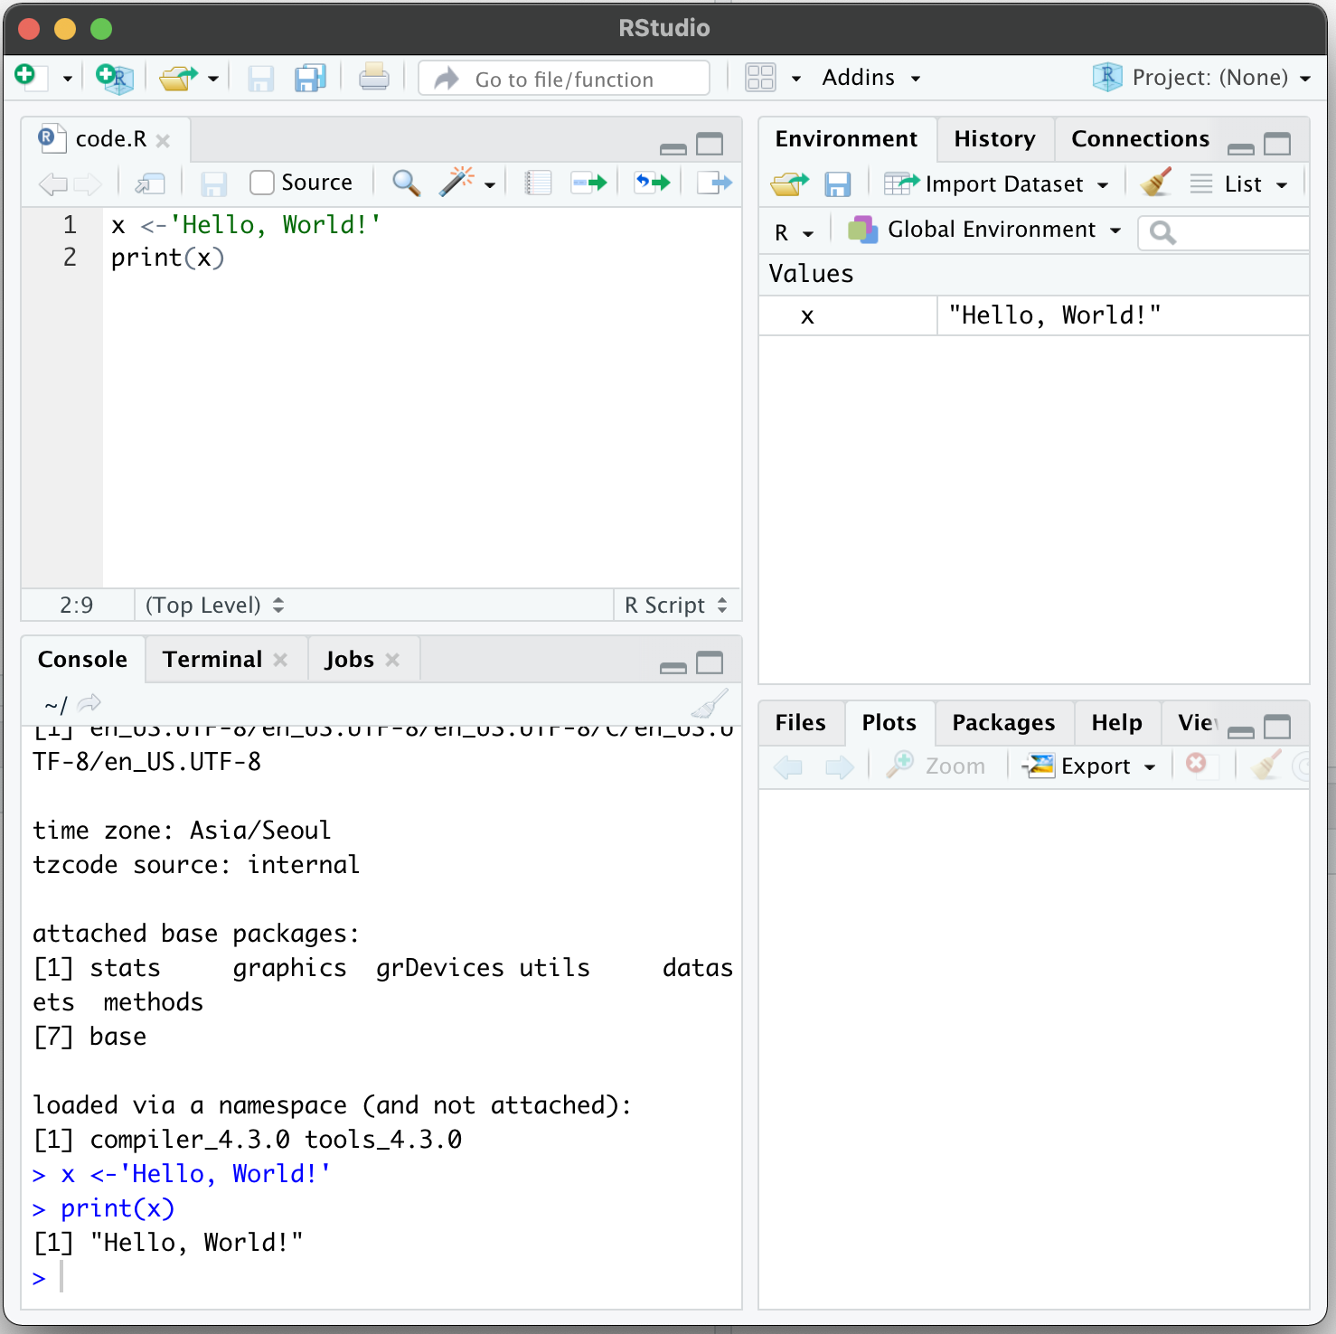
Several ways to use R
Command line
Graphical user interface
Rstudio

Slide 8
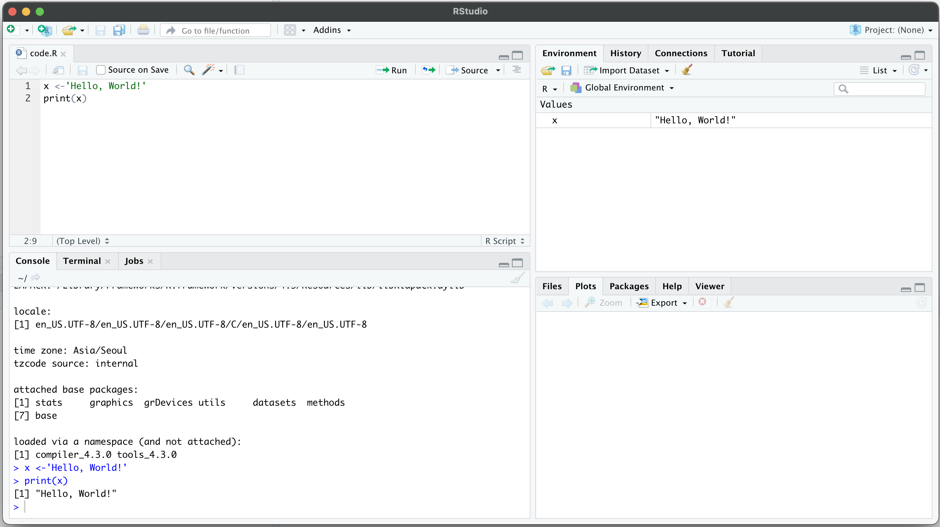
Rstudio
Rstudio – Integrated development environment (IDE) for R and python
Code editor에서 코드를 작성하거나 적혀져 있는 코드를 실행합니다.
Ctrl+Enter를 통해 각 한 줄씩의 코드를 실행할 수 있습니다.
Code editor
Environment / History
R console
Other panes
(Files, Plots, Packages, Help)

Slide 9



Python provides analysis tools that R does not
Some analysis tools are solely based on python
Here we will use squidpy for neighborhood enrichment analysis,
which R does not provide, on chapter 6

Slide 10
2
What is single cell RNA-seq and
Spatial transcriptomics?

Slide 11
Single-cell RNA-seq and Spatial transcriptomics
Single-Cell RNA-Seq provides transcriptional profiling of thousands of individual cells. This level of throughput analysis enables researchers to understand at the single-cell level what genes are expressed, in what quantities, and how they differ across thousands of cells within a heterogeneous sample.
https://web.genewiz.com/single-cell-faq#:~:text=Single%2DCell%20RNA%2DSeq%20provides,cells%20within%20a%20heterogeneous%20sample.
Spatial transcriptomics is a method that enables researchers to spatially localize and quantify gene expression in the form of mRNA transcripts within cells or tissues that are in their native state. Spatial transcriptomics offers an unbiased exploration of mRNA transcripts in situ that can be quantified.
https://nanostring.com/blog/what-is-spatial-gene-expression/

Slide 12
Space Ranger
3

Slide 13
What is Space Ranger?
Space Ranger is a set of analysis pipelines for processing 10X Genomics Visium sequence data (FASTQ files) with high resolution microscope images of tissue.
It maps the transcriptomic reads to the microscope image of the tissue from which the reads were obtained
We will introduce spaceranger count pipeline among the 5 pipelines

Slide 14
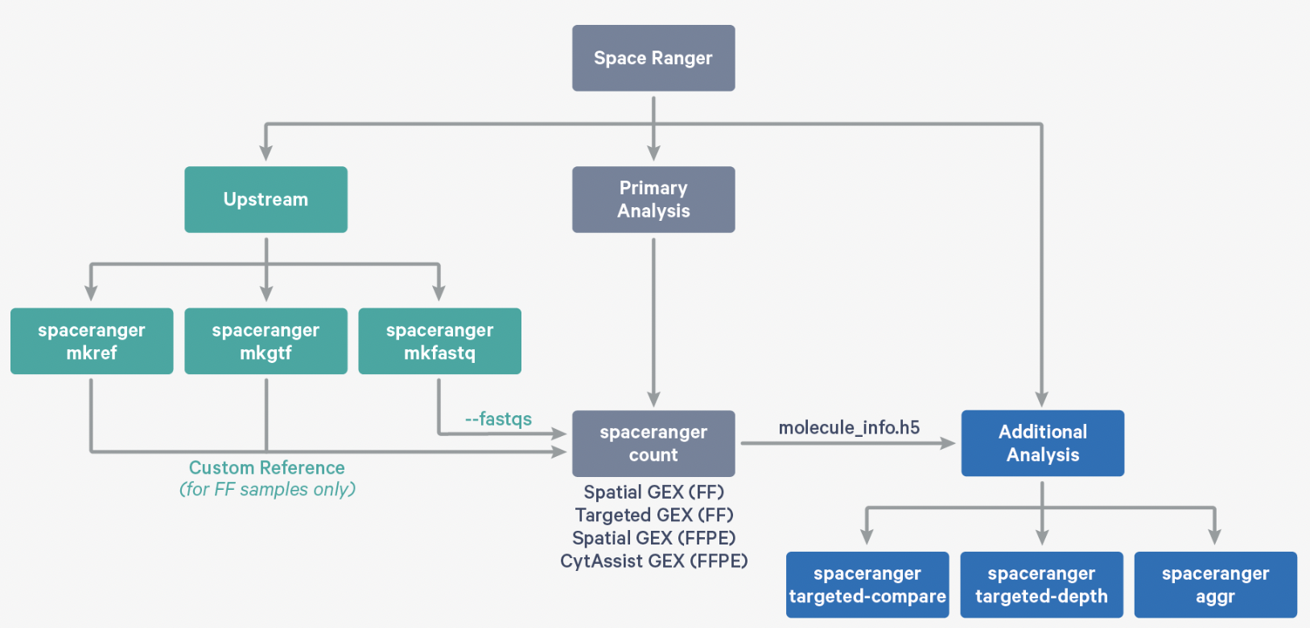
Space Ranger Pipelines
spaceranger mkfastq
spaceranger count
spaceranger aggr
spaceranger targeted-compare
spaceranger targeted-depth
https://support.10xgenomics.com/spatial-gene-expression/software/pipelines/latest/what-is-space-ranger

Slide 15
Installing Space Ranger
Download and unpack the Space Ranger .tar.gz file in any location
Download and unpack proper reference data .tar.gz file in a convenient location
3. Pre-pend the Space Ranger directory to your $PATH
In Terminal
$cd /opt
$tar -xzvf spaceranger-2.0.0.tar.gz
$tar -xzvf refdata-gex-GRCh38-2020-A.tar.gz
$export PATH=/opt/spaceranger-2.0.0:$PATH
https://support.10xgenomics.com/spatial-gene-expression/software/pipelines/latest/installation

Slide 16
Run spaceranger count command
$cd /home/jdoe/runs
$spaceranger count --id=sample345 \ #Output directory
--transcriptome=/home/jdoe/refdata/GRCh38-2020-A \ #Path to Reference
--fastqs=/home/jdoe/runs/HAWT7ADXX/outs/fastq_path \ #Path to FASTQs
--sample=mysample \ #Sample name from FASTQ filename
--image=/home/jdoe/runs/images/sample345.tiff \ #Path to brightfield image
--slide=V19J01-123 \ #Slide ID
--area=A1 \ #Capture area
--localcores=8 \ #Allowed cores in localmode
--localmem=64 #Allowed memory (GB) in localmode
https://support.10xgenomics.com/spatial-gene-expression/software/pipelines/latest/using/count
Input : the microscope image (.tiff), FASTQ files(Fastq)
Perform : sequence alignment, tissue detection
Output : gene-spot matrix

Slide 17
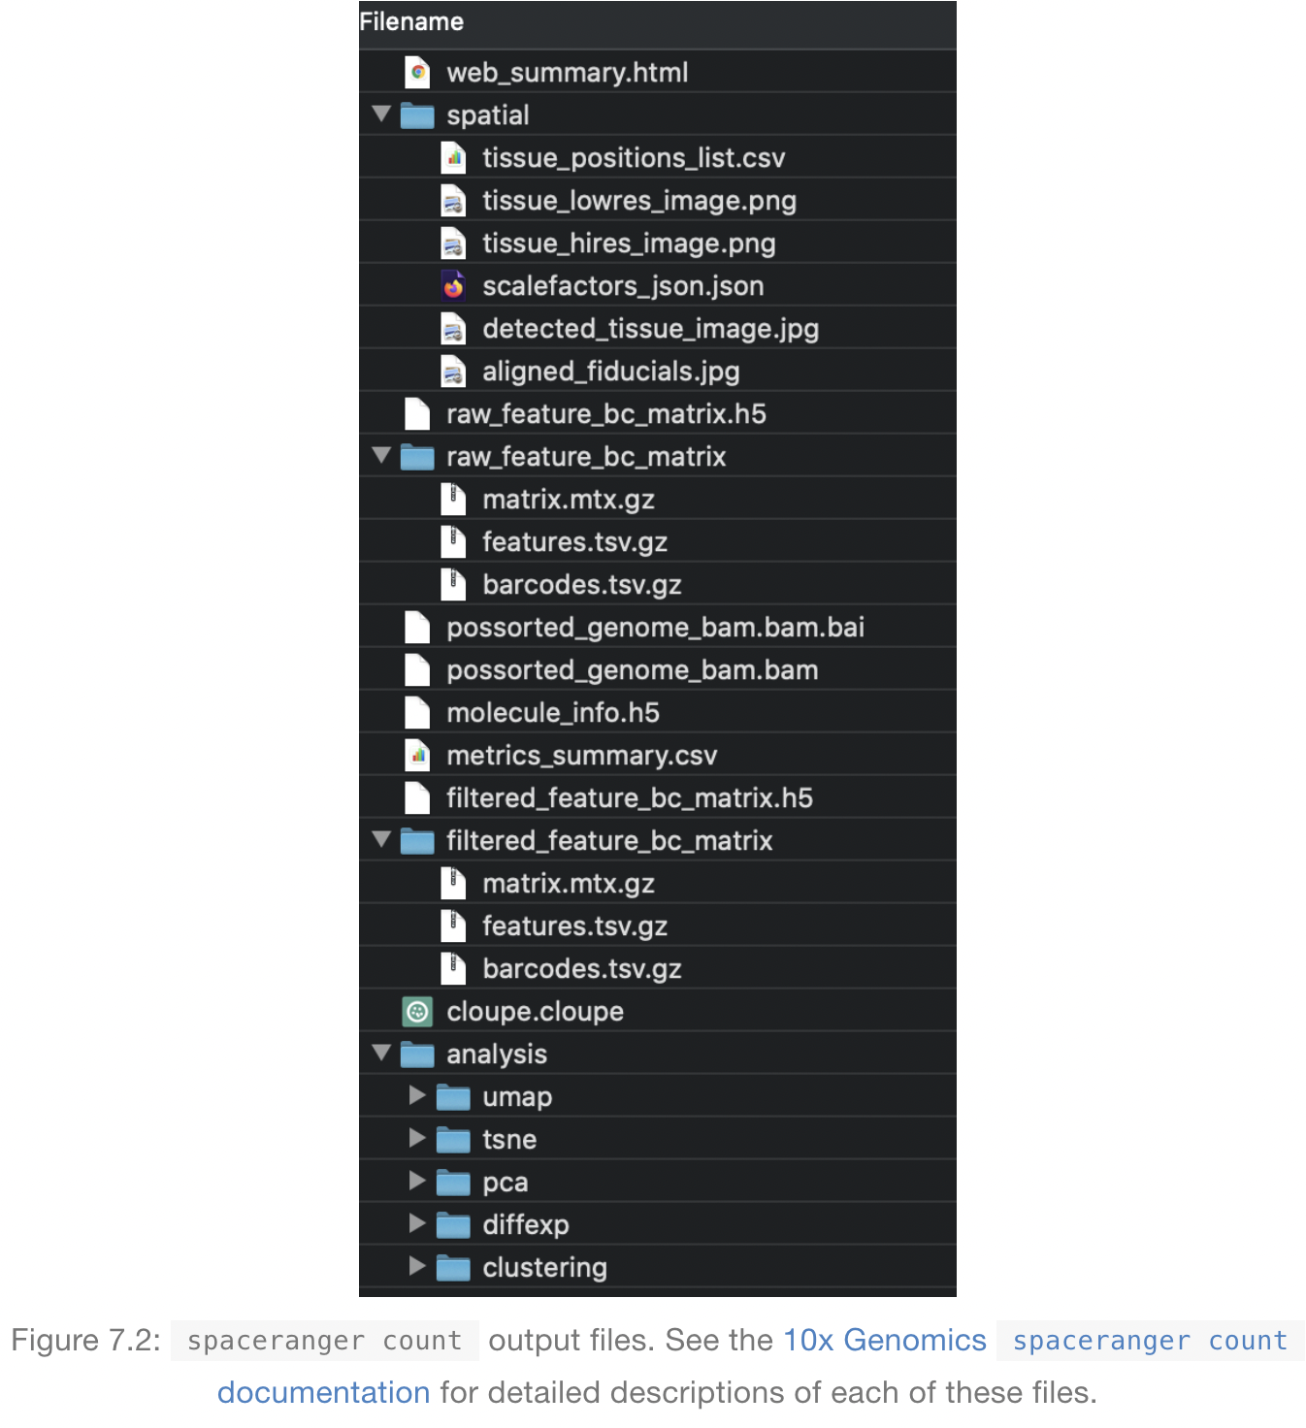
Output files of Space Ranger
VisiumExperiment::read10XVisium
Load10X_Spatial
Input files

Slide 18
Output files
raw_feature_bc_matrix
Dataset having spots that theoretically don’t overlap with tissue
filtered_feature_bc_matrix
Dataset filtered to the spots overlapping tissue, as determined by Loupe Browser
(Visium) alignment file
tissue_positions_list.csv
The spot coordinates information is stored
scalefactors_json.json
Scaling factors that convert spot coordinates to pixel coordinates
metrics_summary.csv
Metrics displayed in the interactive website
web_summary.html
Interactive website

Slide 19
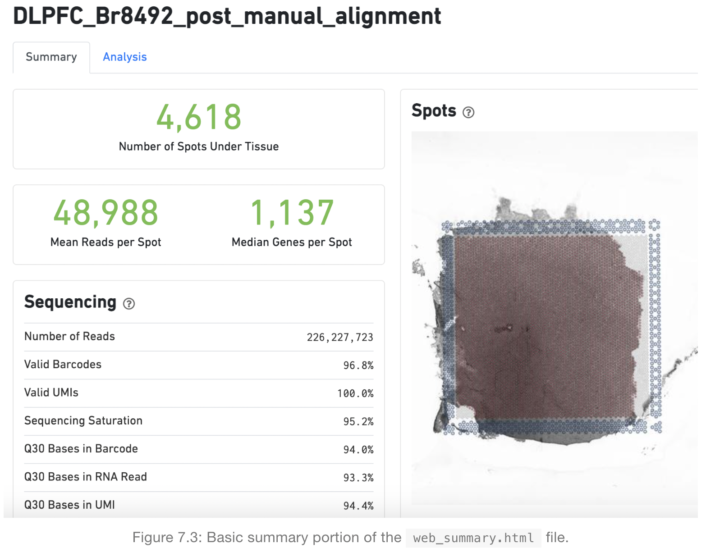
Web summary .html file
https://lmweber.org/OSTA-book/space-ranger-visium.html

Slide 20
Web summary .html file
Metrics | Definition | Expected/Recommended value
Number of Spots Under Tissue | The number of barcodes associated with a spot under tissue.
Mean Reads per Spot | The number of reads, both under and outside of tissue, divided by the number of barcodes associated with a spot under tissue. | Recommended: 50,000
Median Genes per Spot | The median number of genes detected per spot under tissue-associated barcode. Detection is defined as the presence of at least 1 UMI count. | Vary by sample, and low values are not necessarily indicative of a failed experiment
Number of reads | Total number of read pairs that were assigned to this library in demultiplexing. | Fresh frozen libraries: a minimum of 50k FFPE v1 libraries: a minimum of 25k
Valid Barcodes | Fraction of reads with barcodes that match the whitelist* after barcode correction | Expected >75%
Valid UMIs | Fraction of reads with valid UMIs | Expected >75%
Sequencing Saturation | The fraction of reads originating from an already-observed UMI | Dependent upon sequencing depth and sample complexity (at last 60-80% in most applications)
Q30 bases in barcode, Sample Index, or UMI | Fraction of tissue-associated barcode, Sample Index, or UMI bases with Q-Score >= 30, excluding very low quality/no call (Q≤2) bases from the denominator | Sequencing platform dependent (Most Illumina runs generate >70-80% Q30 data)
https://lmweber.org/OSTA-book/space-ranger-visium.html

Slide 21
What is a Loupe Browser?
Loupe Browser is a desktop application from 10x Genomics that allows to visualize gene expression data without having to write code
Align gene expression spots to histological images, look for marker gene expression, annotate populations, and cluster
The .cloupe file is the one that need to import into the Loupe Browser
Generally, 1~2 GB each

Slide 22
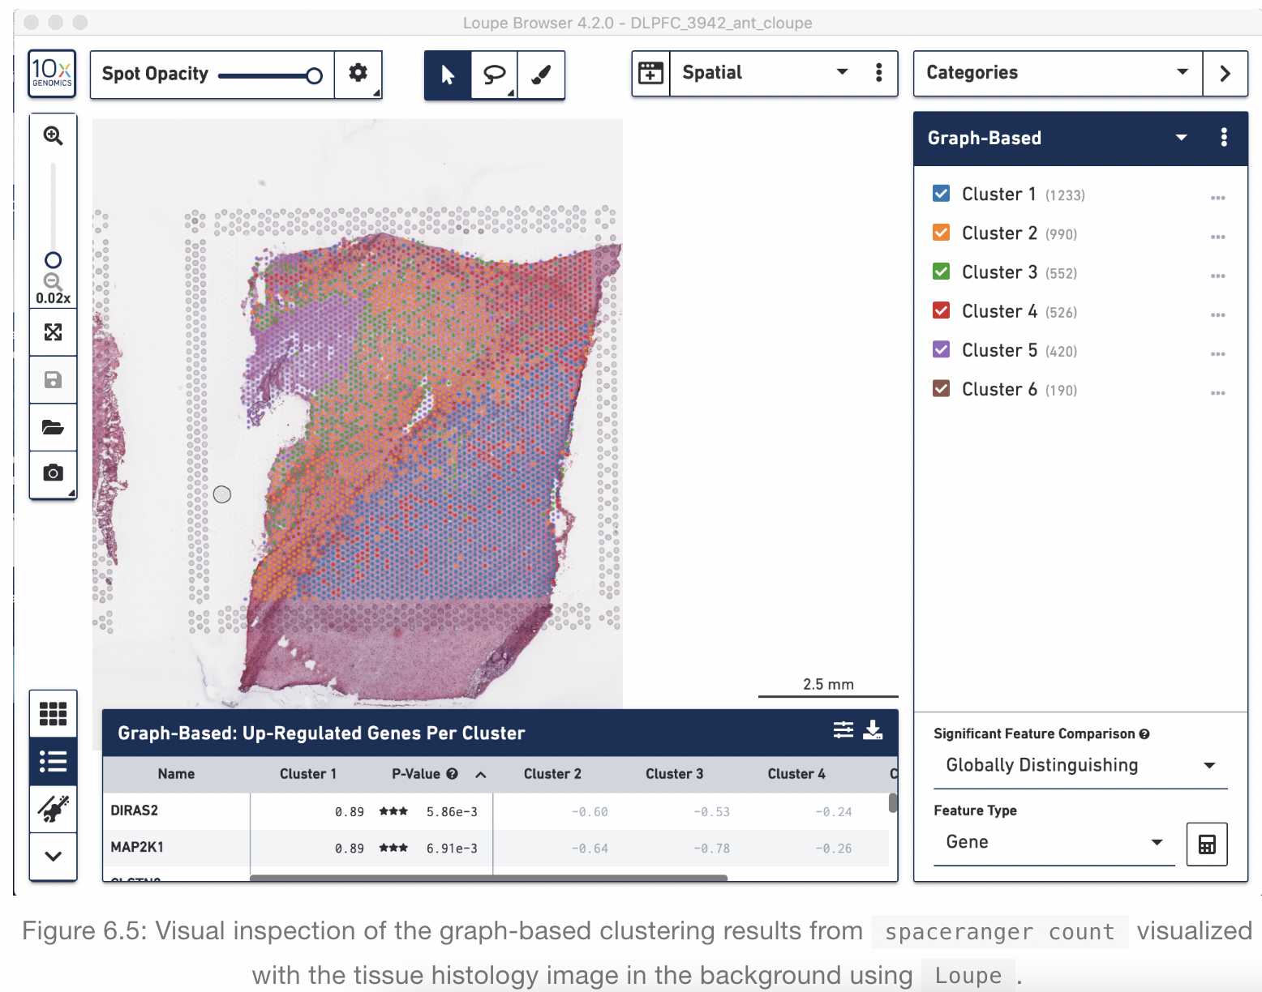
Loupe Browser
Histology image &
UMAP & t-SNE
Manual Annotation of spots
https://support.10xgenomics.com/spatial-gene-expression/software/visualization/latest/analysis

Slide 23
Download R packages to be used in analysis
options(timeout = 600000000)
install.packages("BiocManager")
BiocManager::install("ComplexHeatmap")
BiocManager::install("BiocNeighbors")
BiocManager::install("BiocGenerics")
BiocManager::install("Biobase")
install.packages("hdf5r")
install.packages("dplyr")
install.packages('Seurat')
install.packages("ggplot2")
install.packages("remotes")
install.packages("anndata")
install.packages("cowplot")
install.packages("devtools")
devtools::install_github("thomasp85/patchwork")
devtools::install_github('satijalab/seurat-data')
devtools::install_github("dmcable/spacexr", build_vignettes = FALSE)
remotes::install_github("mojaveazure/seurat-disk")
remotes::install_github("sqjin/CellChat")
remotes::install_github("jbergenstrahle/STUtility")
# Load packages #
library(ComplexHeatmap)
library(BiocNeighbors)
library(BiocGenerics)
library(Biobase)
library(hdf5r)
library(dplyr)
library(Seurat)
library(ggplot2)
library(remotes)
library(anndata)
library(cowplot)
library(devtools)
library(patchwork)
library(SeuratData)
library(SeuratDisk)
library(spacexr)
library(CellChat)
library(STutility)
# For reproducibility set the seed
set.seed(1234)

Slide 24
4
Integrative analysis of
spatial datasets - Seurat

Slide 25
Dataset Description
We will be using a recently released dataset of sagital mouse brain slices generated using the Visium v1 chemistry.
There are two serial anterior sections, and two (matched) serial posterior sections.
Biological annotations of spots (i.e., cell group information) are predicted using Seurat (https://satijalab.org/seurat/articles/spatial_vignette.html).

Slide 26
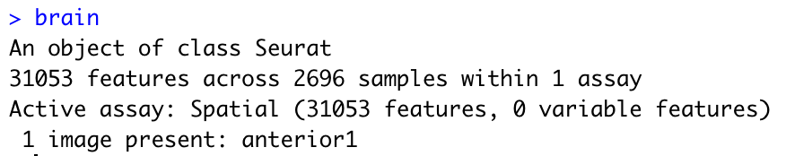
Load brain data and explore Seurat object
Load and preprocessing Visium
Load and preprocessing single cell
Find TransferAnchors
Transfer annotation
# Download the dropbox folder entirely, and you need to specify the downloaded folder directory
setwd("2023_KOGO_summer_workshop_data")
# We can easily download the data with functions below
#options(timeout = 600000000)
#InstallData("stxBrain")
#brain = LoadData("stxBrain", type = "anterior1")
brain <- readRDS("./KOGO_brain.rds")
Same with
brain = readRDS("./KOGO_brain.rds")
brain

Slide 27
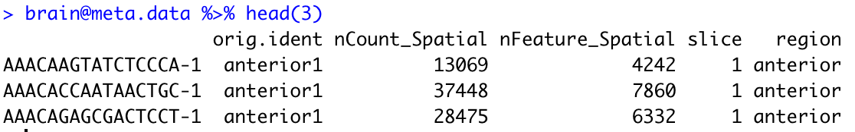
Explore metadata
Load and preprocessing Visium
Load and preprocessing single cell
Find TransferAnchors
Transfer annotation
brain@meta.data %>% head(3)
metadata | explanation
nCount_Spatial | the total number of detected molecules in each sample
nFeature_Spatial | the number of unique genes in each sample
slice | name of the stored image

Slide 28
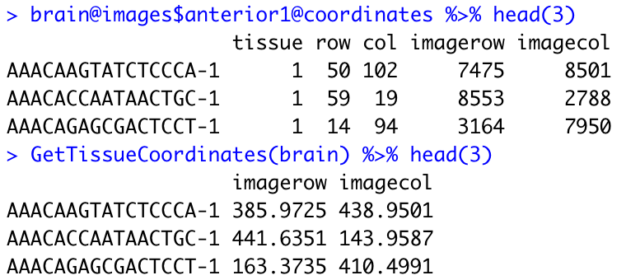
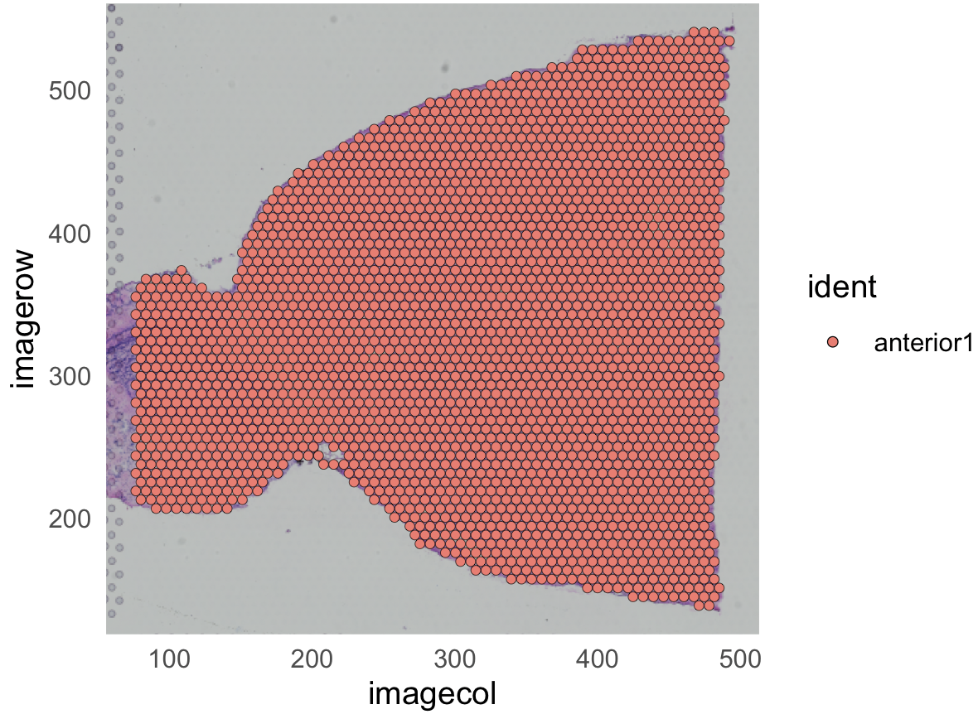
Explore coordinates
Load and preprocessing Visium
Load and preprocessing single cell
Find TransferAnchors
Transfer annotation
brain@images$anterior1@coordinates %>% head(3)
GetTissueCoordinates(brain) %>% head(3)
SpatialPlot(brain) + ggplot2::theme_minimal()
metadata | explanation
tissue | Binary, indicating if the spot falls inside (1) or outside (0) of tissue
row | The row coordinate of the spot in the array from 0 to 77
col | The column coordinate of the spot in the array
imagerow | The row pixel coordinate of the center of the spot in the full resolution image.
imagecol | The column pixel coordinate of the center of the spot in the full resolution image.

Slide 29
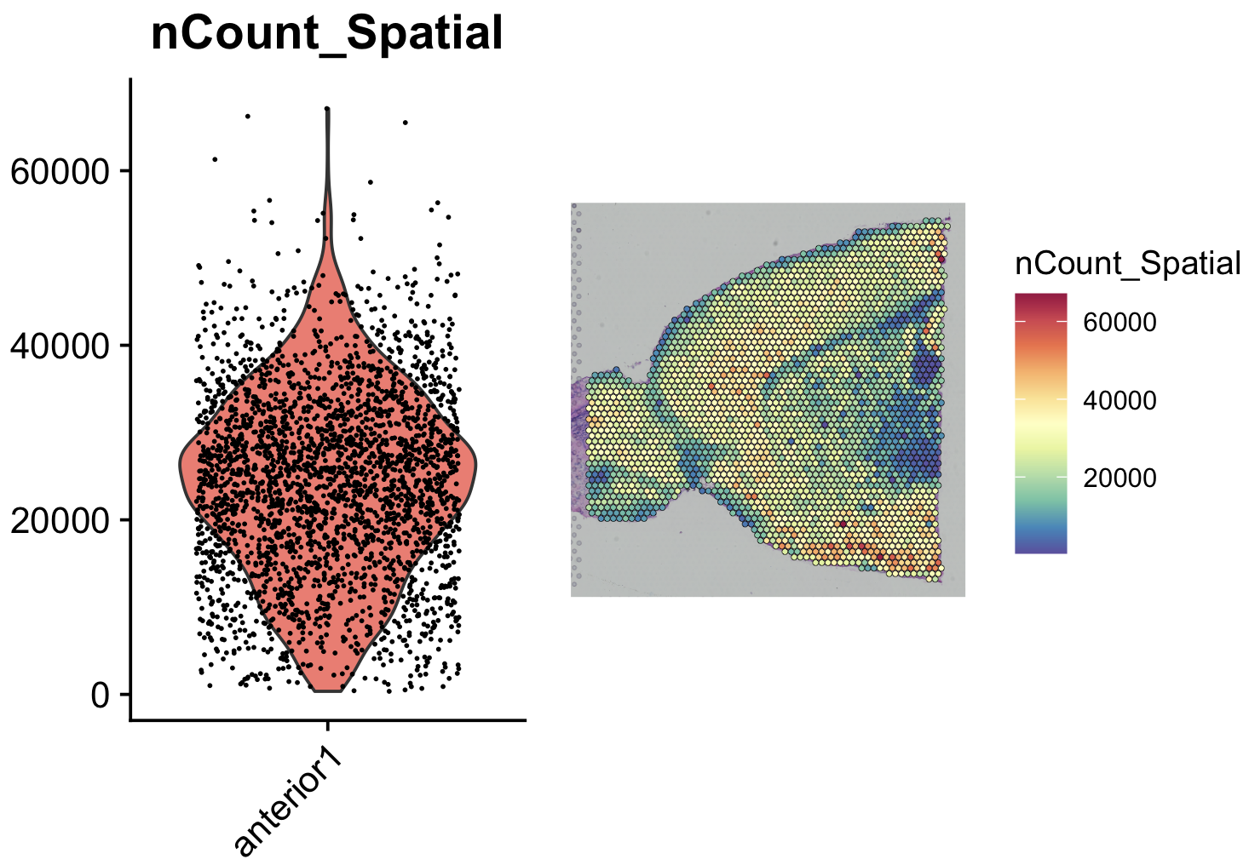
Load Brain data
Load and preprocessing Visium
Load and preprocessing single cell
Find TransferAnchors
Transfer annotation
# nCount_Spatial: the total number of detected molecules in each sample
plot1 = VlnPlot(brain, features = "nCount_Spatial", pt.size = 0.1) + NoLegend()
plot2 = SpatialFeaturePlot(brain, features = "nCount_Spatial") +
theme(legend.position = "right")
# wrap_plots: take a list of plots and add them into one composition
wrap_plots(plot1, plot2)

Slide 30
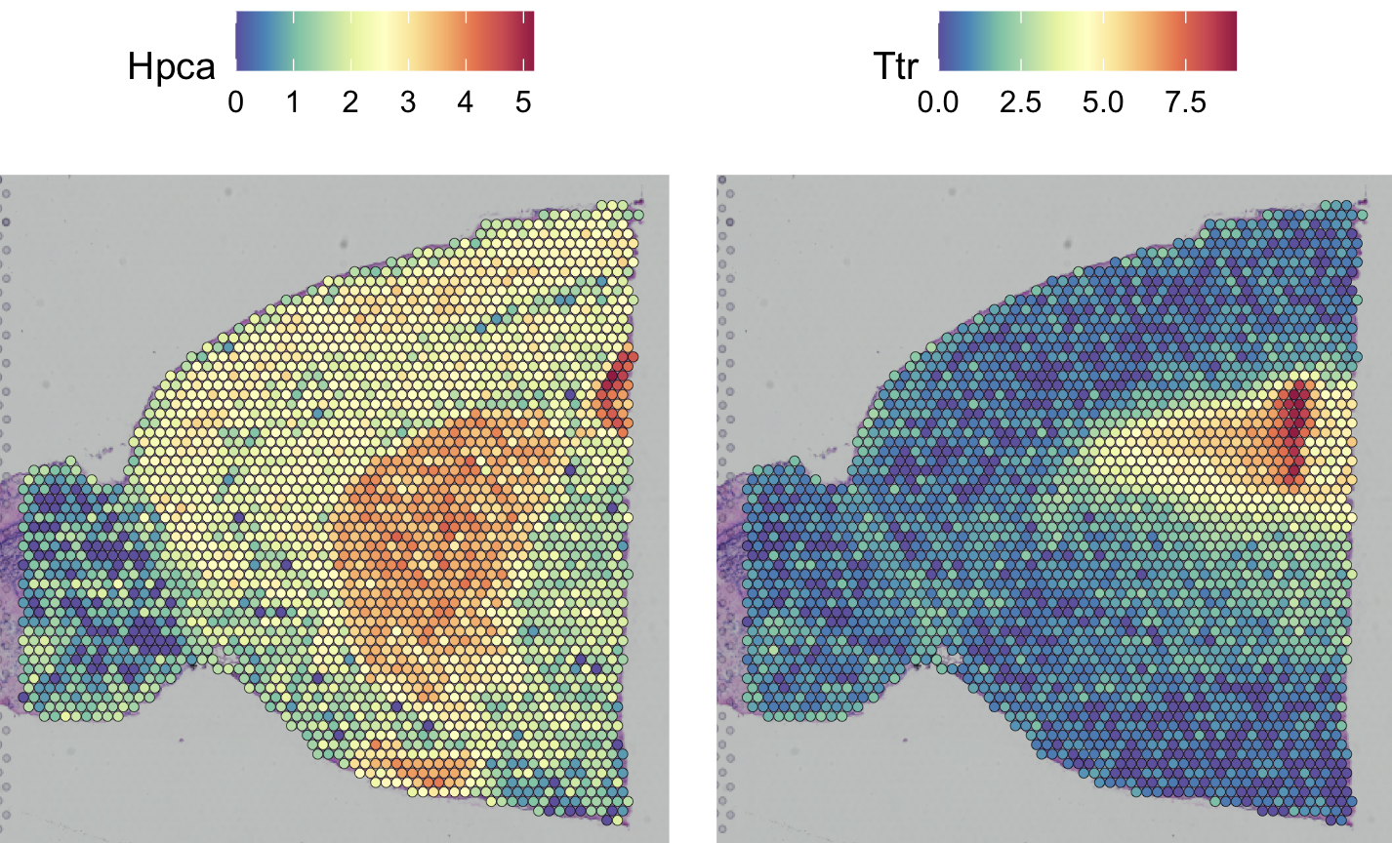
Pre-processing and Visualization of gene expression
Load and preprocessing Visium
Load and preprocessing single cell
Find TransferAnchors
Transfer annotation
# SCTransform calculates a model of technical noise using 'regularized negative binomial regression’.
This replaces NormalizeData, ScaleData, and FindVariableFeatures.
brain = SCTransform(brain, assay = "Spatial", verbose = FALSE)
gc()
SpatialFeaturePlot(brain, features = c("Hpca", "Ttr"))

Slide 31
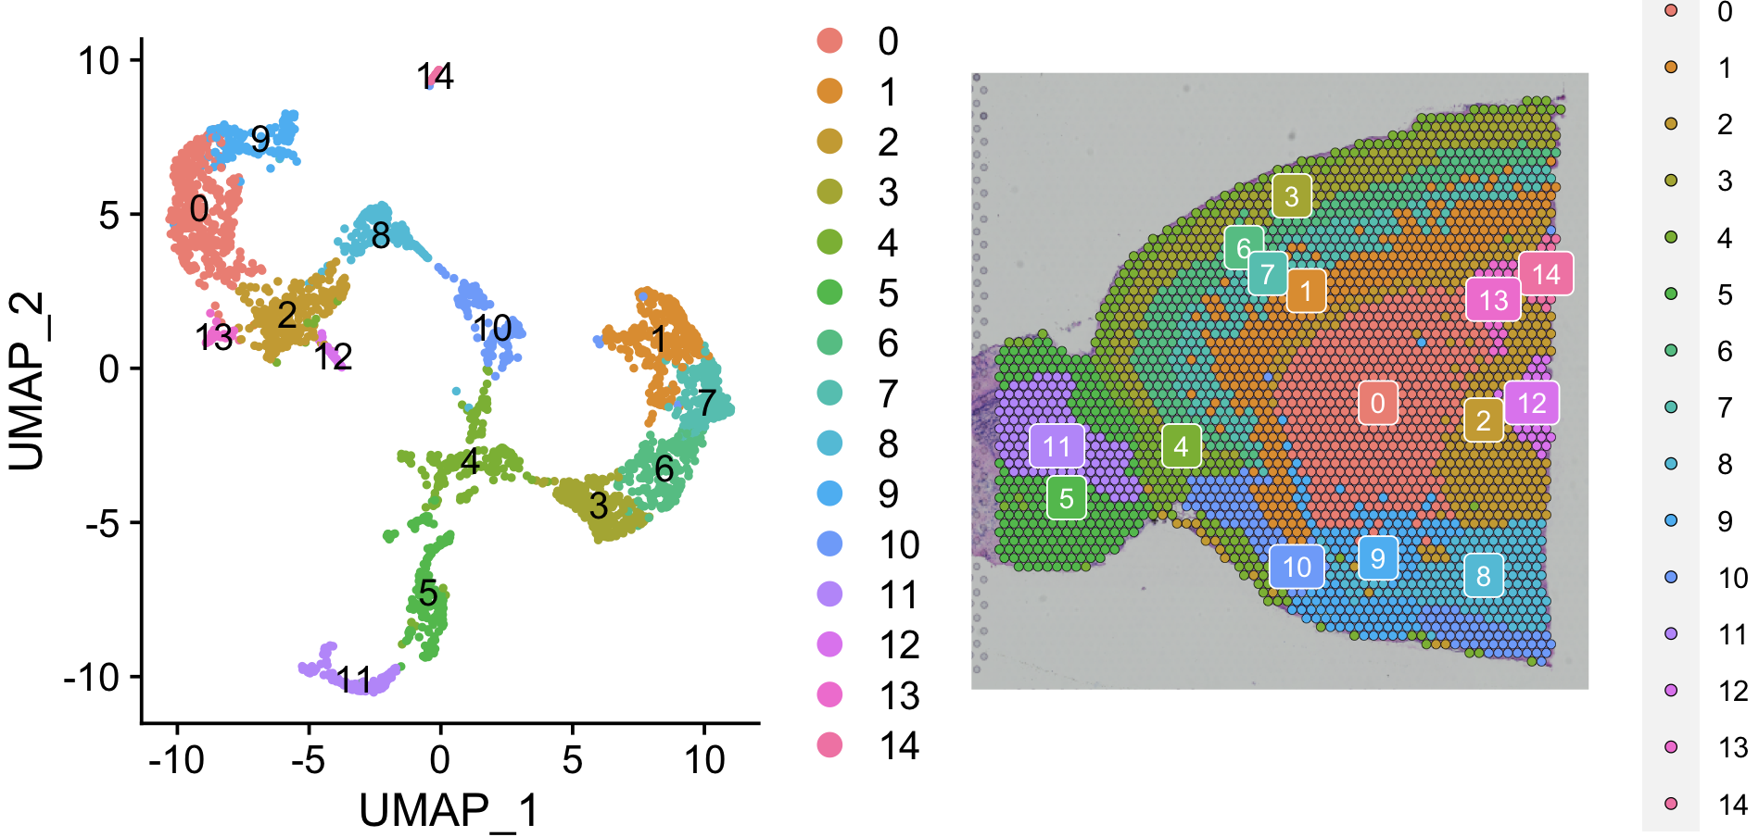
Dimension reduction and clustering
Load and preprocessing Visium
Load and preprocessing single cell
Find TransferAnchors
Transfer annotation
# PCA dimensionality reduction
brain = RunPCA(brain, assay = "SCT", verbose = FALSE)
# Compute an SNN (Shared Nearest-neighbor) on the gene expression level
brain = FindNeighbors(brain, reduction = "pca", dims = 1:30)
brain = FindClusters(brain, verbose = FALSE)
brain = RunUMAP(brain, reduction = "pca", dims = 1:30)
p1 = DimPlot(brain, reduction = "umap", label = TRUE)
p2 = SpatialDimPlot(brain, label = TRUE, label.size = 3)
p1 + p2

Slide 32
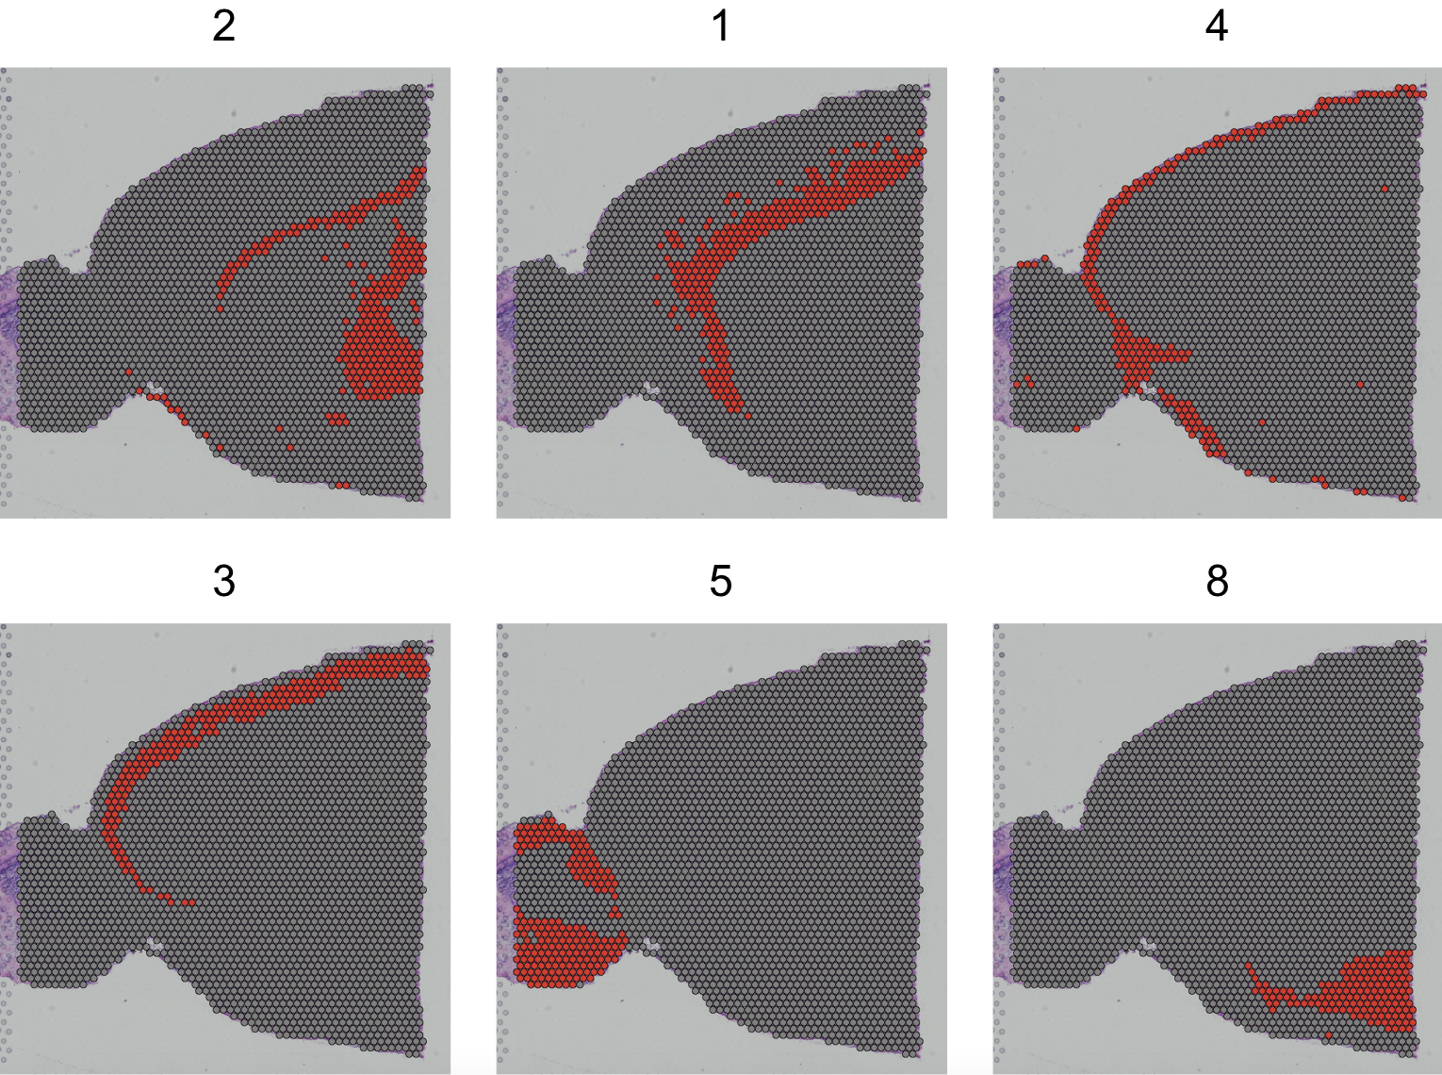
Spatial Dimplot of some cluster
Load and preprocessing Visium
Load and preprocessing single cell
Find TransferAnchors
Transfer annotation
# facet.highlight: split each group into its own plot
SpatialDimPlot(brain, cells.highlight = CellsByIdentities(object = brain,
idents = c(2, 1, 4, 3, 5, 8)), facet.highlight = TRUE, ncol = 3)

Slide 33
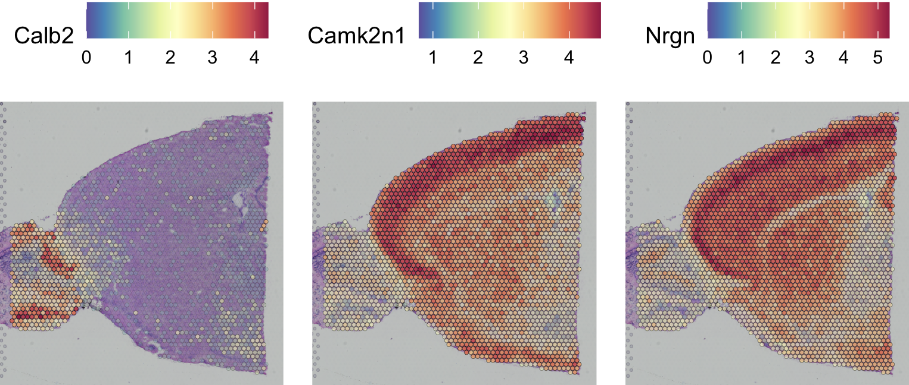
Identification of spatially variable features
Load and preprocessing Visium
Load and preprocessing single cell
Find TransferAnchors
Transfer annotation
# We can find cluster 5 markers compared to cluster 6
de_markers = FindMarkers(brain, ident.1 = 5, ident.2 = 6)
SpatialFeaturePlot(object = brain, features = rownames(de_markers)[1:3],
alpha = c(0.1, 1), ncol = 3)
# saveRDS(brain, "./KOGO_visium_brain_processed.rds")

Slide 34
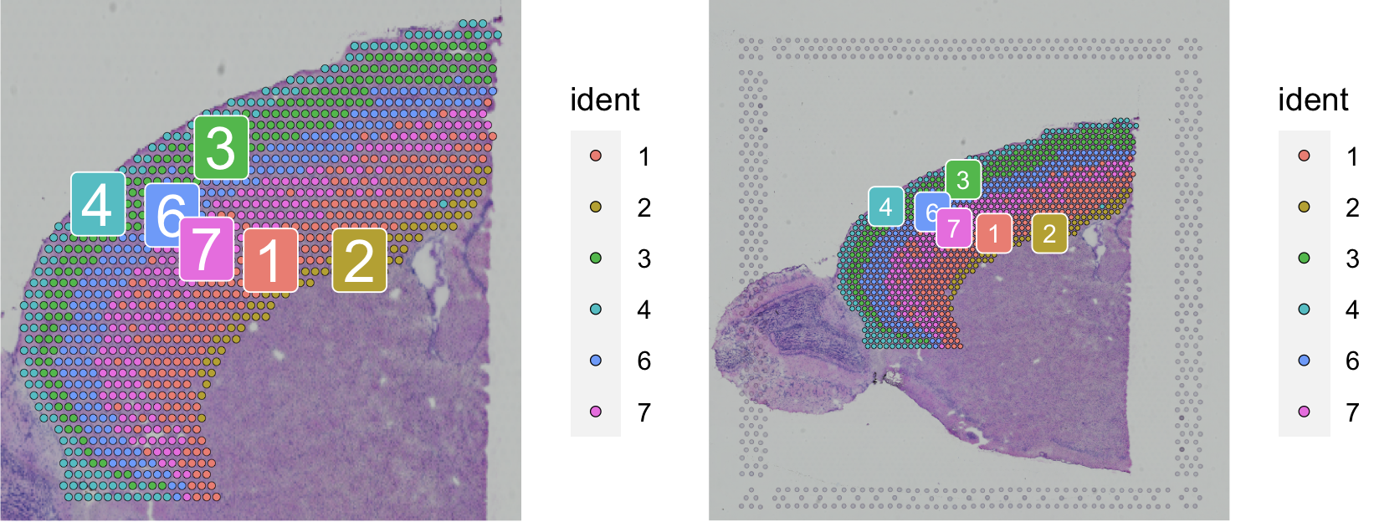
Subset out anatomical regions
Load and preprocessing Visium
Load and preprocessing single cell
Find TransferAnchors
Transfer annotation
cortex = subset(brain, idents = c(1, 2, 3, 4, 6, 7))
rm(brain)
gc()
cortex = subset(cortex, anterior1_imagerow > 400 | anterior1_imagecol < 150, invert = TRUE)
cortex = subset(cortex, anterior1_imagerow > 275 & anterior1_imagecol > 370, invert = TRUE)
cortex = subset(cortex, anterior1_imagerow > 250 & anterior1_imagecol > 440, invert = TRUE)
p1 = SpatialDimPlot(cortex, crop = TRUE, label = TRUE)
p2 = SpatialDimPlot(cortex, crop = FALSE, label = TRUE, pt.size.factor = 1, label.size = 3)
# We merge two plots
p1 + p2
cortex = SCTransform(cortex, assay = "Spatial", verbose = FALSE) %>% RunPCA(verbose = FALSE)
# saveRDS(cortex, "./KOGO_visium_cortex_processed.rds")

Slide 35
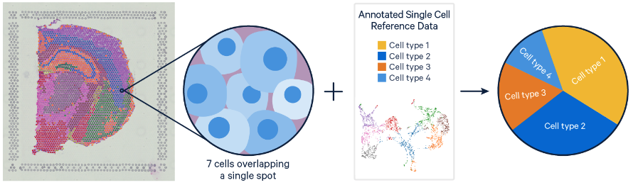
Integrate single cell and visium spatial gene expression data
Load and preprocessing Visium
Load and preprocessing single cell
Find TransferAnchors
Transfer annotation
Elucidate spatiality in single cell data and improve resolution in Visium data
Problem
Single Cell RNAseq methods resolve gene expression at the single cell level, but lose the spatial context.
Visium spatial gene expression maintains spatial information, but the resolution of each spot is limited (1-10 cells).
Solution
- Deconvolution (Identify the cell types and their relative proportions contributing to a spot)
- Mapping (Assign the most likely dominant cell type to a spot)
https://www.10xgenomics.com/resources/analysis-guides/integrating-single-cell-and-visium-spatial-gene-expression-data

Slide 36
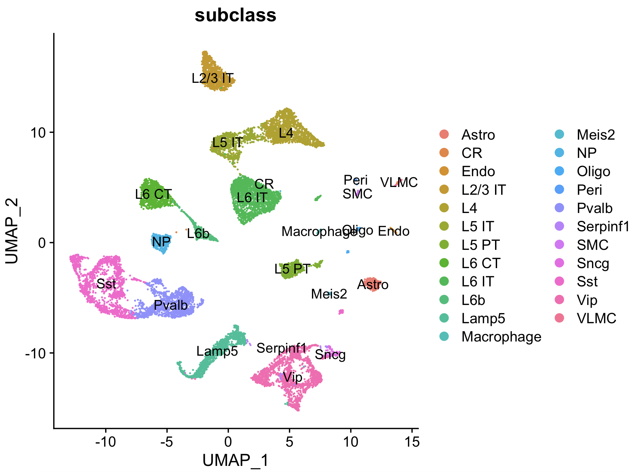
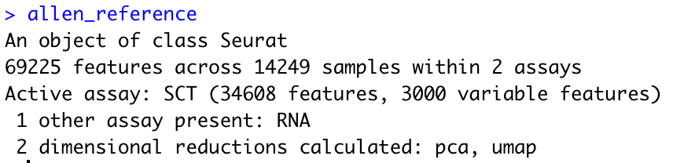
Load reference single cell data
Load and preprocessing Visium
Load and preprocessing single cell
Find TransferAnchors
Transfer annotation
# allen_reference = readRDS("./KOGO_sc_allen_cortex.rds")
# allen_reference = SCTransform(allen_reference, ncells = 3000, verbose = FALSE) %>%
# RunPCA(verbose = FALSE) %>% RunUMAP(dims = 1:30) # 컴퓨터 사양에 따라 5-20분 소요.
allen_reference = readRDS("./KOGO_sc_allen_cortex_processed.rds")
DimPlot(allen_reference, group.by = "subclass", label = TRUE)

Slide 37
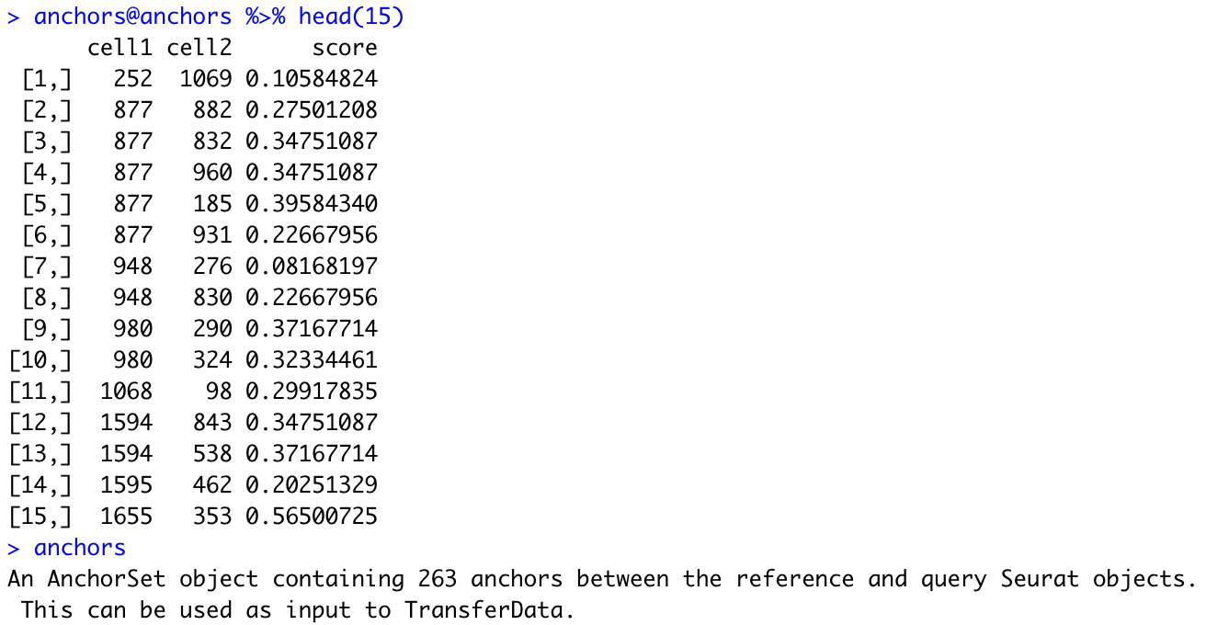
Find TransferAnchors
Load and preprocessing Visium
Load and preprocessing single cell
Find TransferAnchors
Transfer annotation
# anchors: cross-dataset pairs that are in a matched biological state
# Find a set of anchors between a reference and query object. These anchors can later be used to
transfer data from the reference to query object using the TransferData object.
anchors = FindTransferAnchors(reference = allen_reference, query = cortex, normalization.method = "SCT")
anchors@anchors %>% head(15)
anchors
gc()

Slide 38
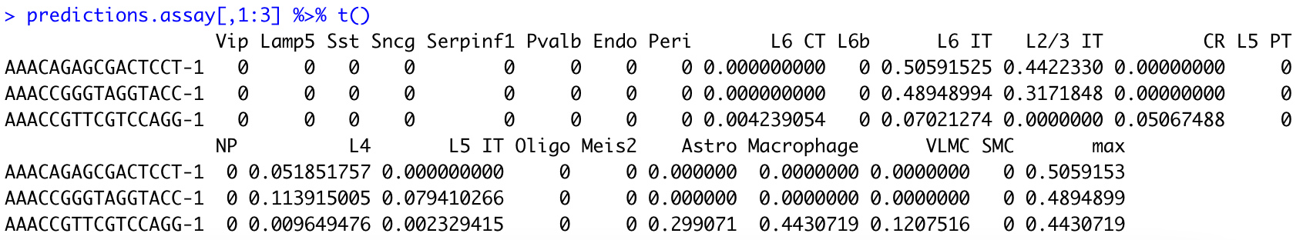
Acquire prediction assay
Load and preprocessing Visium
Load and preprocessing single cell
Find TransferAnchors
Transfer annotation
# TransferData: Transfer categorical or continuous data across single-cell datasets
# weight.reduction: Dimensional reduction to use for the weighting anchors
predictions.assay = TransferData(anchorset = anchors, refdata = allen_reference$subclass, prediction.assay = TRUE,
weight.reduction = cortex[["pca"]], dims = 1:30)
predictions.assay[,1:3] %>% t()

Slide 39
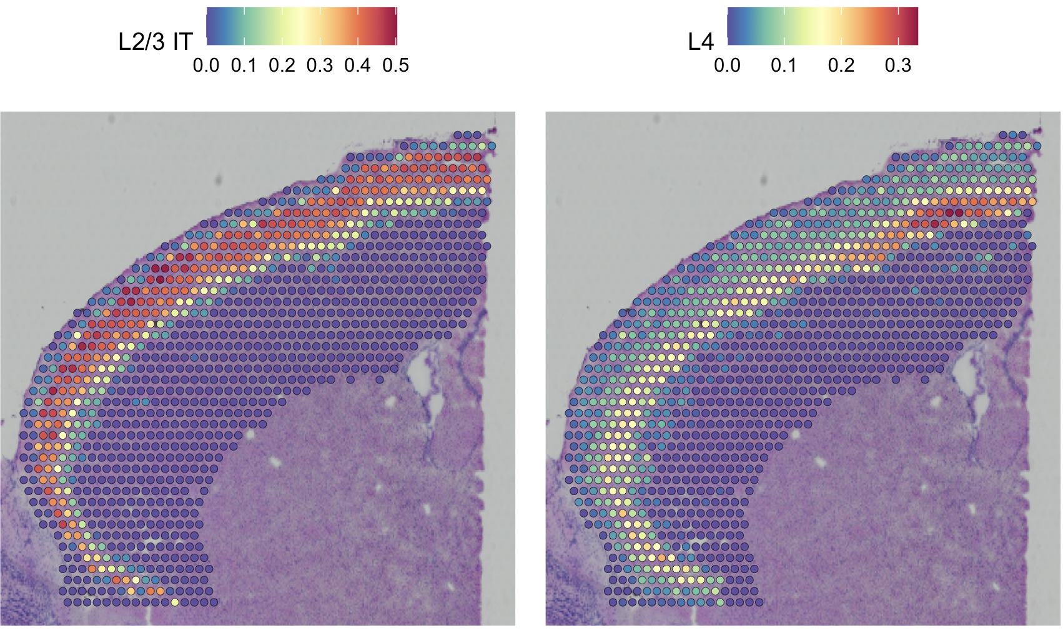
Insert the prediction assay into the cortex object
Load and preprocessing Visium
Load and preprocessing single cell
Find TransferAnchors
Transfer annotation
# Created prediction assay
cortex[["predictions"]] = predictions.assay
DefaultAssay(cortex) = "predictions”
SpatialFeaturePlot(cortex, features = c("L2/3 IT", "L4"),
pt.size.factor = 1.6, ncol = 2, crop = TRUE)

Slide 40
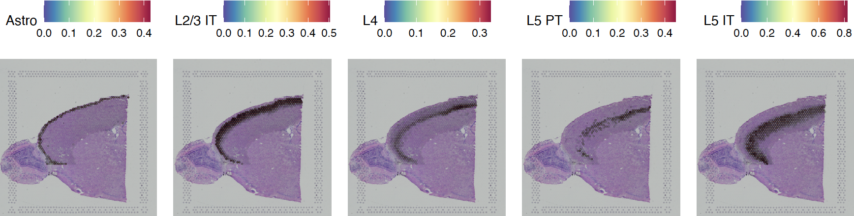
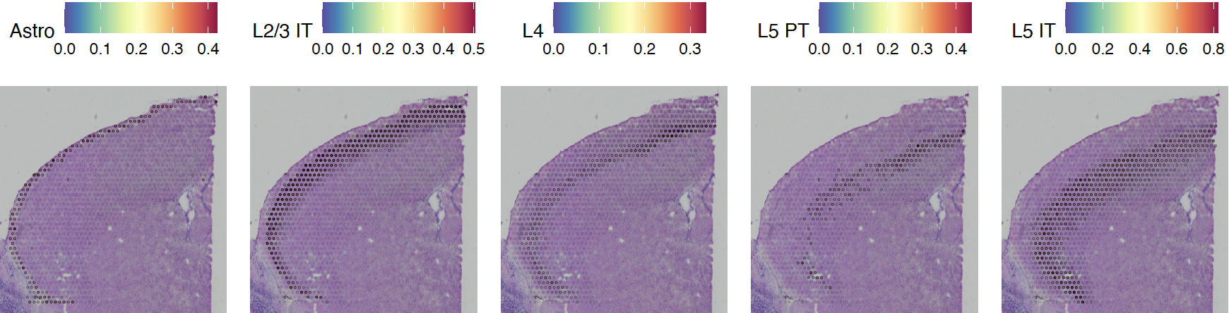
Spatial Feature Plot of predicted cell type proportion
Load and preprocessing Visium
Load and preprocessing single cell
Find TransferAnchors
Transfer annotation
pdf('./integreated_spatialfeautrePlot.pdf', width = 10, height = 5)
SpatialFeaturePlot(cortex, features = c("Astro", "L2/3 IT", "L4", "L5 PT", "L5 IT"), pt.size.factor = 1, ncol = 5,
crop = FALSE, alpha = c(0.1, 1))
SpatialFeaturePlot(cortex, features = c("Astro", "L2/3 IT", "L4", "L5 PT", "L5 IT"), pt.size.factor = 1, ncol = 5,
crop = T, alpha = c(0.1, 1))
dev.off()

Slide 41
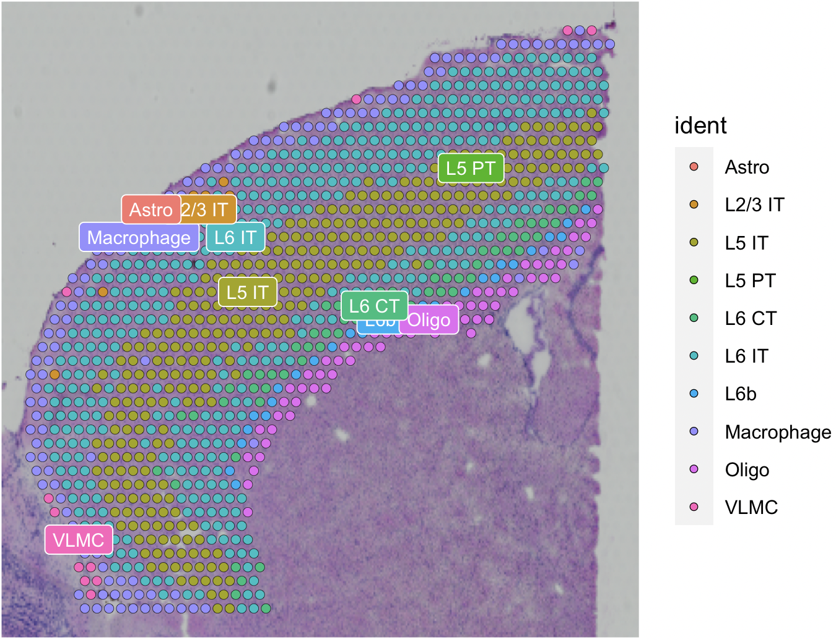
Transfer annotation
Load and preprocessing Visium
Load and preprocessing single cell
Find TransferAnchors
Transfer annotation
# We also get predicted cell type metadata for each spot
predictions = TransferData(anchorset = anchors, refdata = allen_reference$subclass,
weight.reduction = cortex[["pca"]], dims = 1:30)
cortex = AddMetaData(cortex, metadata = predictions)
cortex$predicted.id = factor(cortex$predicted.id)
cortex = SetIdent(cortex, value = "predicted.id")
SpatialDimPlot(cortex, label = T, label.size = 3)

Slide 42
Remove all objects before starting next chapter
rm(allen_reference)
rm(brain)
rm(cortex)
rm(anchors)
rm(predictions);
rm(predictions.assay);
rm(de_markers)
rm(p1)
rm(p2)
rm(plot1)
rm(plot2)
gc()

Slide 43
Deconvolution analysis - SpaceXR
5

Slide 44
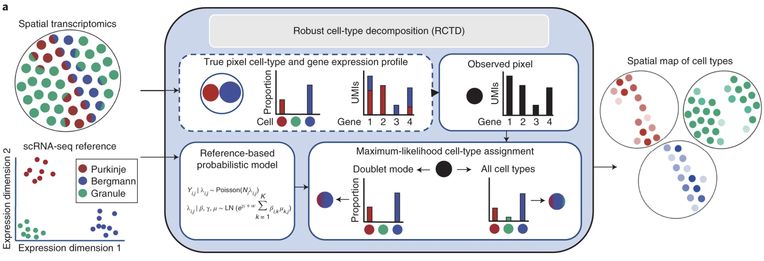
Robust Cell Type Decomposition (RCTD) Algorithm
Process single cell for RCTD input
Process spatial for RCTD input
Run RCTD
Process output for deconvolution
Cable, Dylan M., et al. “Robust decomposition of cell type mixtures in spatial transcriptomics.” Nature Biotechnology 40.4 (2022): 517-526.
Calculate the mean gene expression profile of each cell type within the scRNA-seq reference.
Use an scRNA-seq reference-based probabilistic model to predict cell types on a single pixel containing a mixture of two cell types with unknown cell type proportions.
Predict the maximum-likelihood cell type proportions.

Slide 45
Load RCTD input reference dataset (single cell)
Process single cell for RCTD input
Process spatial for RCTD input
Run RCTD
Process output for deconvolution
allen_reference = readRDS(”./KOGO_sc_allen_cortex.rds")
allen_reference = subset(allen_reference, subclass != c("CR"))
Exclude CR cell type since since it needs a minimum of 25 cells for each cell type in the reference.

Slide 46
Prepare single cell dataset for RCTD input
Process single cell for RCTD input
Process spatial for RCTD input
Run RCTD
Process output for deconvolution
counts_sc = allen_reference$RNA@counts
meta_sc = allen_reference@meta.data
allen_reference = SetIdent(allen_reference, value="subclass")
# Rename the cluster due to prohibited characters “/”
allen_reference = RenameIdents(allen_reference, "L2/3 IT" = "L2_3 IT")
allen_reference$subclass = allen_reference@active.ident
annotation_sc = allen_reference@meta.data$subclass
names(annotation_sc) = rownames(meta_sc)
annotation_sc = as.factor(annotation_sc)
nUMI_sc = meta_sc$nCount_RNA
names(nUMI_sc) = rownames(meta_sc)
reference = Reference(counts_sc, annotation_sc, nUMI_sc)

Slide 47
Process spatial dataset for RCTD input
Process single cell for RCTD input
Process spatial for RCTD input
Run RCTD
Process output for deconvolution
brain = readRDS(”./KOGO_visium_brain_processed.rds")
counts_visium = brain@assays$Spatial@counts
nUMI_visium = colSums(counts_visium)
coords_visium = brain@images$anterior1@coordinates[,c("col","row")]
query = SpatialRNA(coords_visium, counts_visium, nUMI_visium)

Slide 48
Run RCTD in doublet mode
Process single cell for RCTD input
Process spatial for RCTD input
Run RCTD
Process output for deconvolution
RCTD = create.RCTD(query, reference, max_cores = 8)
RCTD = run.RCTD(RCTD, doublet_mode = 'doublet’) #30 mins
brain = AddMetaData(brain, metadata = RCTD@results$results_df)
# Save RCTD results
write.csv(RCTD@results$results_df, "./KOGO_visium_brain_RCTD.csv")

Slide 49
Process RCTD decomposed file
Process single cell for RCTD input
Process spatial for RCTD input
Run RCTD
Process output for deconvolution
RCTD = read.table("./KOGO_visium_brain_RCTD.csv", sep = ",", header = TRUE)
meta_RCTD = RCTD[,c("X", "first_type")]
colnames(meta_RCTD) = c("barcodes", "spacexr_first_type")
rownames(meta_RCTD) = meta_RCTD$barcodes; meta_RCTD$barcodes <- NULL
brain = AddMetaData(brain, meta_RCTD)
brain = SetIdent(brain, value = "spacexr_first_type")

Slide 50
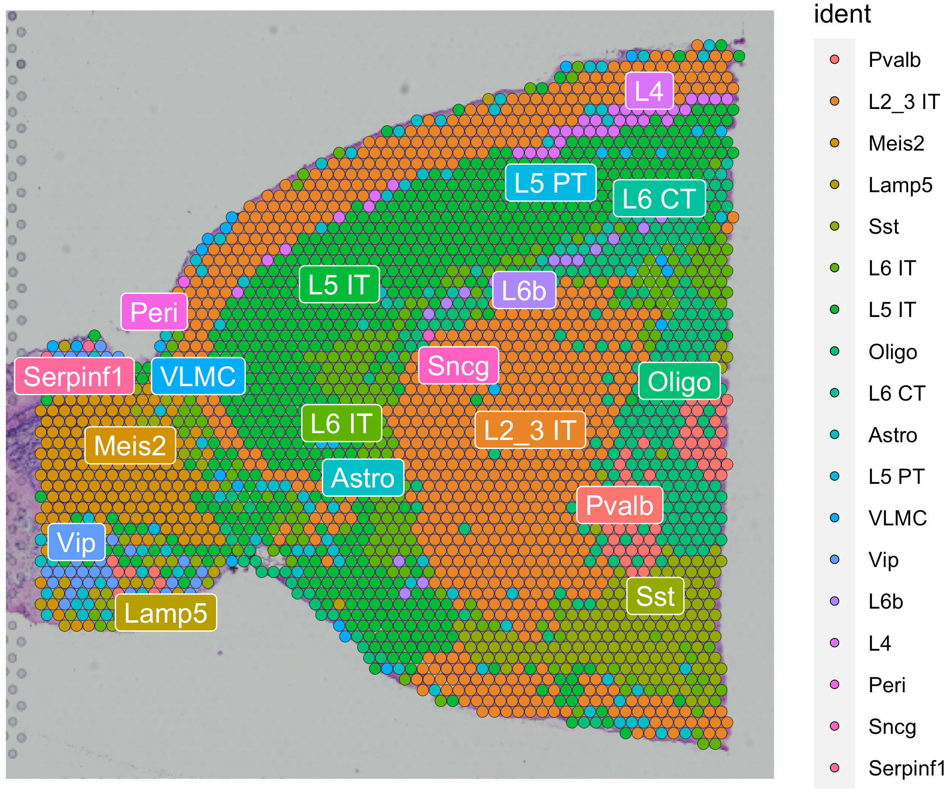
Brain spatial map of predicted cell type by RCTD
Process single cell for RCTD input
Process spatial for RCTD input
Run RCTD
Process output for deconvolution
SpatialDimPlot(brain, label = T, label.size = 4, repel = T)

Slide 51
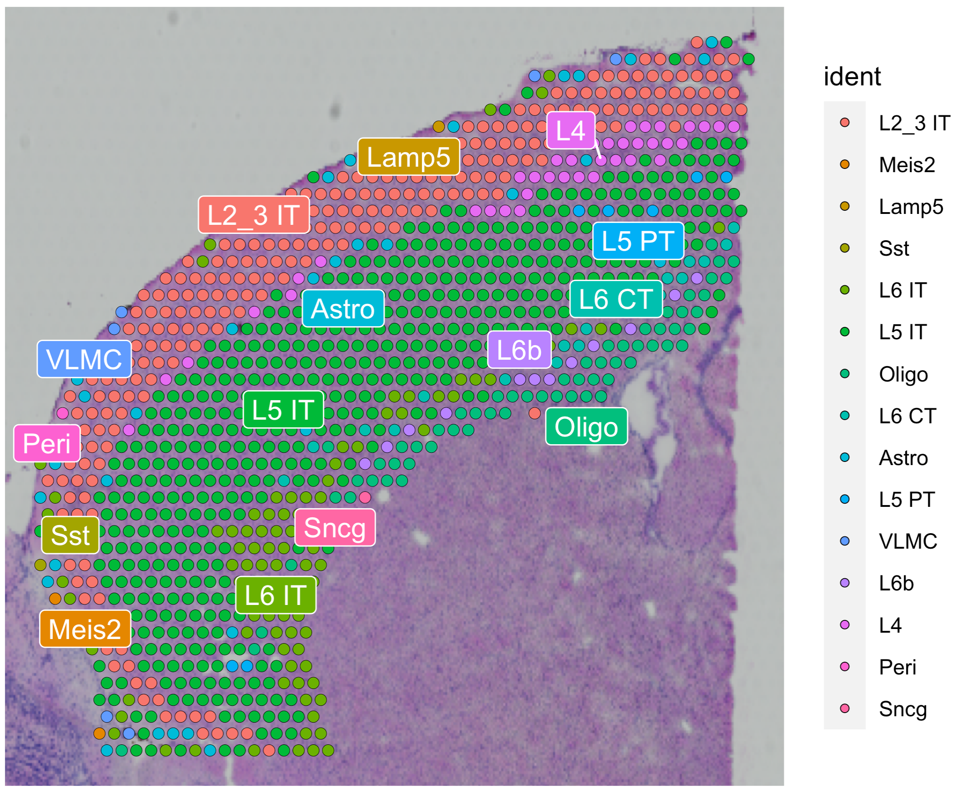
Cortex spatial map of predicted cell type by RCTD
Process single cell for RCTD input
Process spatial for RCTD input
Run RCTD
Process output for deconvolution
cortex = subset(brain, seurat_clusters %in% c(1, 2, 3, 4, 6, 7))
cortex = subset(cortex, anterior1_imagerow > 400 | anterior1_imagecol < 150, invert = TRUE)
cortex = subset(cortex, anterior1_imagerow > 275 & anterior1_imagecol > 370, invert = TRUE)
cortex = subset(cortex, anterior1_imagerow > 250 & anterior1_imagecol > 440, invert = TRUE)
SpatialDimPlot(cortex, label = T, label.size = 4, repel = T)
# This file will be used in the Squidpy and CellChat Analysis
saveRDS(cortex, "./KOGO_visium_cortex_annotated.rds")

Slide 52
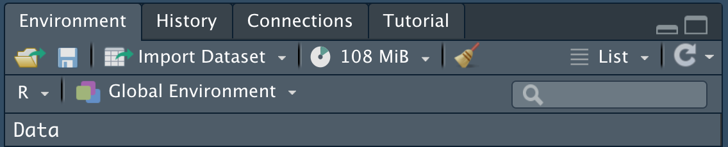
Remove all objects before starting next chapter
Process single cell for RCTD input
Process spatial for RCTD input
Run RCTD
Process output for deconvolution
Clear objects from the workspace.
# clean up memory in R
gc()

Slide 53
Neighborhood Analysis of Co-occurrence - Squidpy
6

Slide 54
Install Squidpy via Conda
Install Squidpy
Convert / load data
Neighborhood enrichment analysis
Co-occurrence analysis
Please create a conda environment using Anaconda Prompt on windows or terminal on macOS.
$cd {PATH_TO_2023_KOGO_summer_workshop_data}
$conda env create -f environment.yml
$python -m pip install --upgrade pip
$python -m pip install jupyter
$conda activate squidpy
$conda install -c anaconda ipykernel
$python -m ipykernel install --user --name squidpy
$conda deactivate
$jupyter notebook

Slide 55
Convert data from Seurat object to Anndata
Install Squidpy
Convert / load data
Neighborhood enrichment analysis
Co-occurrence analysis
In R
#You can convert the seurat object to anndata by running the command lines below or download KOGO_visium_cortex_anndata.h5ad.
cortex = readRDS("./KOGO_visium_cortex_annotated.rds")
cortex = AddMetaData(cortex, cortex@images$anterior1@coordinates)
cortex = UpdateSeuratObject(cortex)
SaveH5Seurat(cortex, filename = "./KOGO_visium_cortex_anndata.h5Seurat")
Convert("./KOGO_visium_cortex_anndata.h5Seurat", dest = "h5ad")

Slide 56
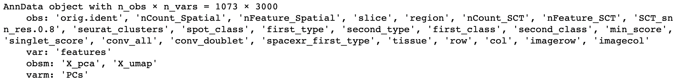
Load the anndata and explore how it looks like
Install Squidpy
Convert / load data
Neighborhood enrichment analysis
Co-occurrence analysis
In Python
import scanpy as sc
import anndata as ad
import squidpy as sq
import numpy as np
import pandas as pd adata = ad.read_h5ad("./KOGO_visium_cortex_anndata.h5ad")
adata
n_obs: cell number
n_vars: variable gene number
obs: info of seurat@metadata

Slide 57
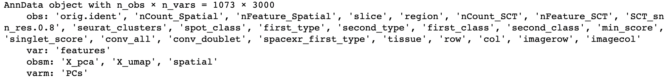
Save spatial information in adata.obsm
Install Squidpy
Convert / load data
Neighborhood enrichment analysis
Co-occurrence analysis
In Python
# make an array having spatial coordinates
spatial_info = adata.obs[['row', 'col']].values.tolist()
adata.obsm['spatial'] = np.array(spatial_info)
adata

Slide 58
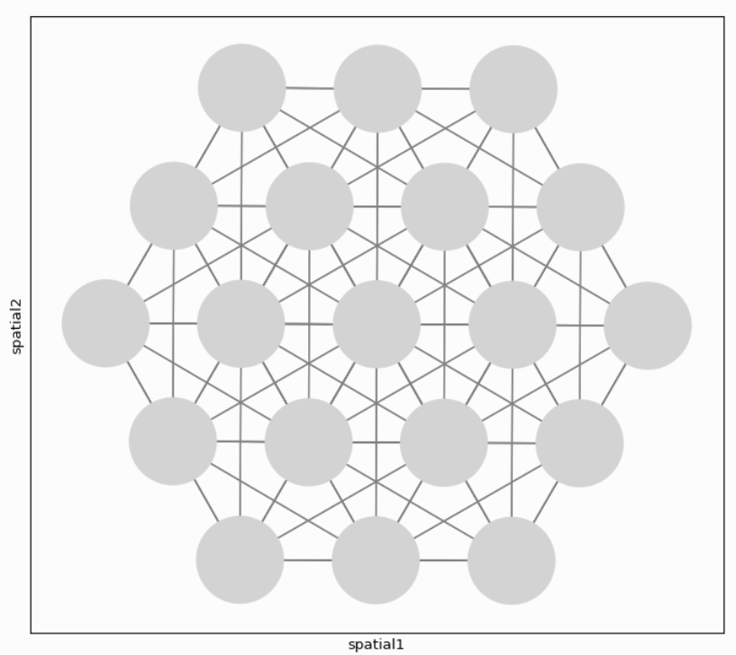
Builds a spatial graph
Install Squidpy
Convert / load data
Neighborhood enrichment analysis
Co-occurrence analysis
In Python
sq.gr.spatial_neighbors(adata)
# Adjacency matrix
adata.obsp["spatial_connectivities"]
# Weighted Adjacency matrix
adata.obsp["spatial_distances"]
Build spatial graph with observations( = spots) as nodes and neighbor-hood relations between observations as edges.
To identify neighbors, spatial coordinates of spots are used.

Slide 59
Calculate enrichment score based on spatial graph
Install Squidpy
Convert / load data
Neighborhood enrichment analysis
Co-occurrence analysis
In Python
adata.obs['spacexr_first_type'] = adata.obs['spacexr_first_type'].astype('category')
sq.gr.nhood_enrichment(adata, cluster_key="spacexr_first_type")
Enrichment score is calculated based on permutation-based test involving spatial graph.
If the observed score is higher than the expected score, spots belonging to two different clusters can be defined as being enriched.

Slide 60
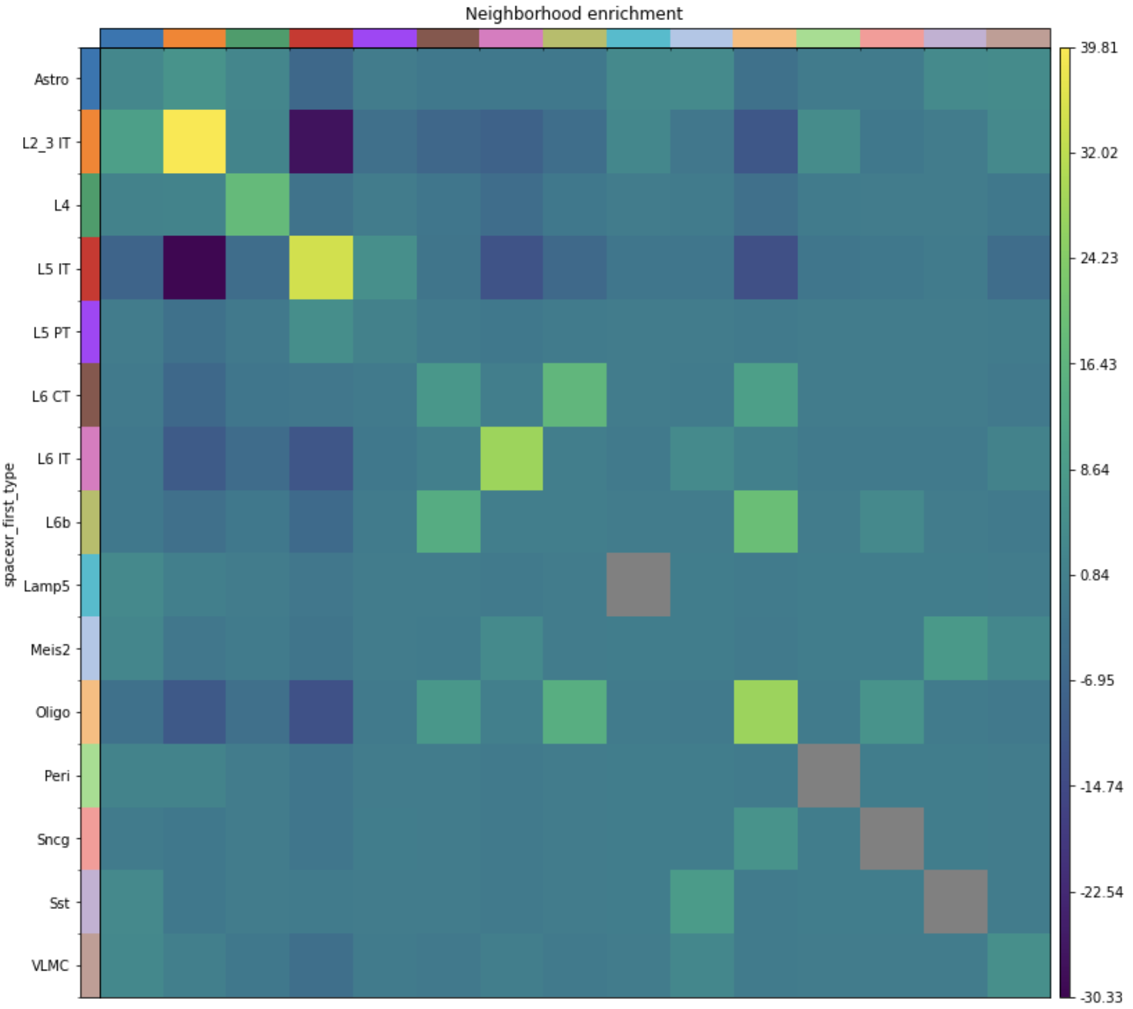
Visualize neighborhood enrichment and select the pair
Install Squidpy
Convert / load data
Neighborhood enrichment analysis
Co-occurrence analysis
In Python
sq.pl.nhood_enrichment(adata, cluster_key = "spacexr_first_type")
Except for diagonal squares, Oligo – L6b pair has the highest enrichment. (red boxed)
L6b
Oligo

Slide 61
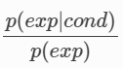
Calculate co-occurrence probability
Install Squidpy
Convert / load data
Neighborhood enrichment analysis
Co-occurrence analysis
In Python
sq.gr.co_occurrence(adata, cluster_key="spacexr_first_type")
Co-occurrence also shows the closeness of two different clusters but without involving spatial graph. It is operated on the original spatial coordinates. The co-occurrence score is defined as: p(exp|cond): conditional probability of observing a cluster exp conditioned on the presence of a cluster cond. p(exp): probability of observing exp in the radius size of interest.
The score is computed across increasing radii size around each spots in the tissue.

Slide 62
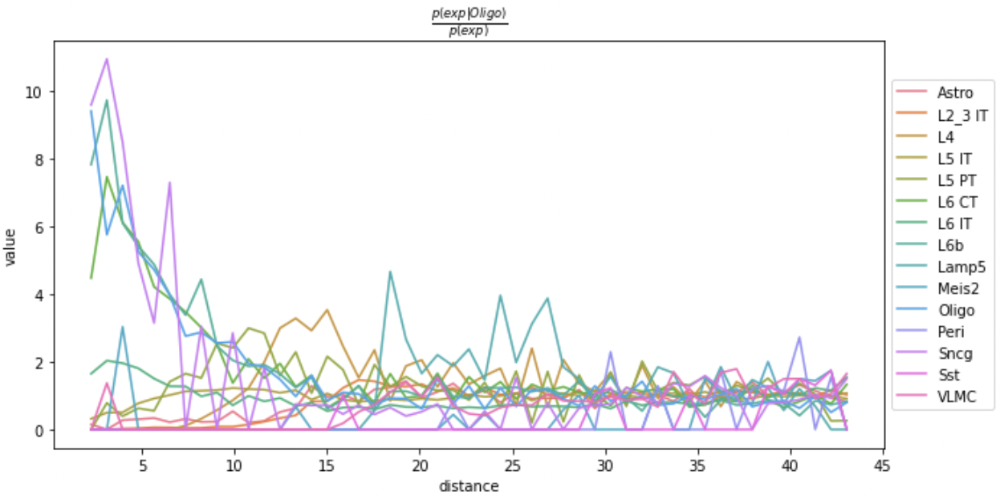
Visualizing co-occurrence of other cell types with oligodendrocytes
Install Squidpy
Convert / load data
Neighborhood enrichment analysis
Co-occurrence analysis
In Python
# Set cond as Oligo by param ‘clusters’
sq.pl.co_occurrence(adata, cluster_key = "spacexr_first_type", clusters = ”Oligo", figsize = (8*1.2, 4*1.2))
Oligodendrocytes show high co-occurrence with L6b. This is consistent with the neighborhood enrichment result.
L6b

Slide 63
7
Cell-cell interaction analysis
- CellChat

Slide 64

What is CellChat?
CellChat is an useful tool to quantitatively infer and analyze intercellular communication networks from single-cell RNA-sequencing data and spatial transcriptomics data.
Requires gene expression and spatial location data of spots/cells as the user input and models the probability of cell-cell communication by integrating gene expression with spatial distance as well as prior knowledge of the interactions between signaling ligands, receptors and their cofactors.
JIN, Suoqin, et al. Inference and analysis of cell-cell communication using CellChat. Nature communications, 2021, 12.1: 1-20.
https://htmlpreview.github.io/?https://github.com/sqjin/CellChat/blob/master/tutorial/CellChat_analysis_of_spatial_imaging_data.html

Slide 65
Load data
Load dataset
Preprocessing
Inference of cell-cell communication network
Visualization network
# Load cell type annotated visium data and set levels for the downstream analysis.
visium.brain = readRDS('./KOGO_visium_cortex_annotated.rds')
visium.brain$spacexr_first_type = factor(visium.brain$spacexr_first_type, levels=c("Astro", "L2_3 IT", "L4", "L5 IT", "L5 PT",
"L6 CT", "L6 IT", "L6b", "Lamp5", "Meis2”, "Oligo", "Peri", "Sncg", "Sst", "VLMC"))
Idents(visium.brain) = visium.brain$spacexr_first_type
colors = scPalette(nlevels(visium.brain))
names(colors) = c("Astro", "L2_3 IT", "L4", "L5 IT", "L5 PT", "L6 CT", "L6 IT", "L6b", "Lamp5", "Meis2", "Oligo", "Peri", "Sncg", "Sst", "VLMC")

Slide 66
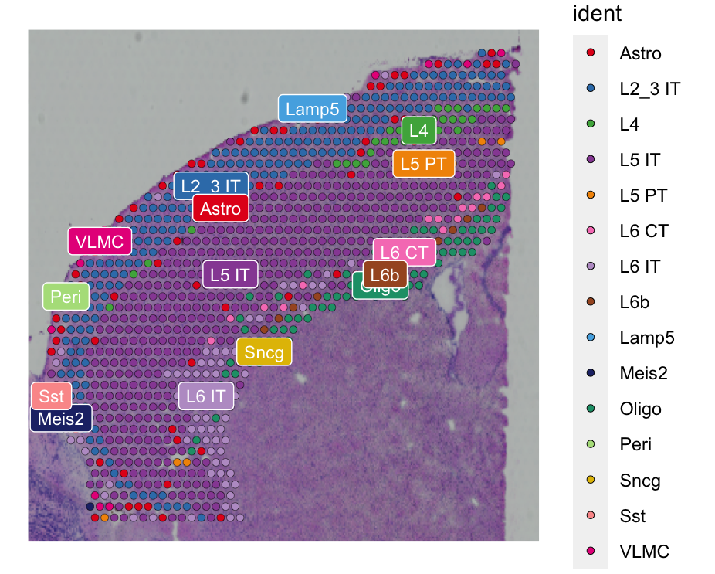
Visualization of our data
Load dataset
Preprocessing
Inference of cell-cell communication network
Visualization network
SpatialDimPlot(visium.brain, label = T, label.size = 3, cols = colors)
There are 15 cell types from our visium data.

Slide 67
Prepare input data for CellChat analysis
Load dataset
Preprocessing
Inference of cell-cell communication network
Visualization network
data.input = GetAssayData(visium.brain, slot = "data", assay = "SCT")
meta = data.frame(labels = Idents(visium.brain),
row.names = names(Idents(visium.brain)))
# check the cell labels
unique(meta$labels)

Slide 68
Load spatial imaging information
Load dataset
Preprocessing
Inference of cell-cell communication network
Visualization network
# Load spatial imaging information to get the spot information.
spatial.locs = GetTissueCoordinates(visium.brain, scale = NULL,
cols = c("imagerow", "imagecol"))
scale.factors = jsonlite::fromJSON(txt = "KOGO_scalefactors_json.json")
scale.factors = list(spot.diameter = 65,
spot = scale.factors$spot_diameter_fullres,
fiducial = scale.factors$fiducial_diameter_fullres,
hires = scale.factors$tissue_hires_scalef,
lowres = scale.factors$tissue_lowres_scalef)

Slide 69
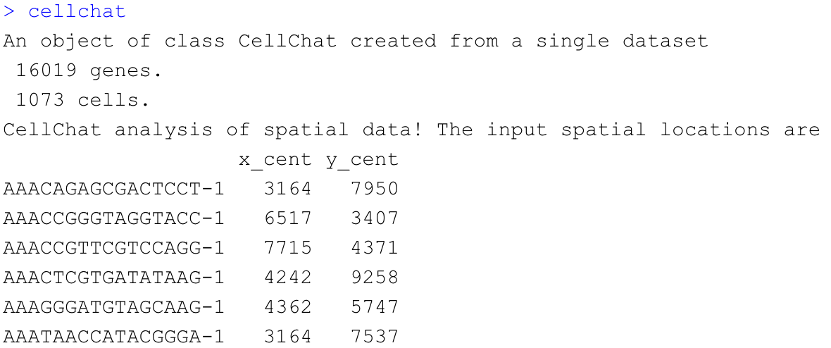
Create a CellChat object
Load dataset
Preprocessing
Inference of cell-cell communication network
Visualization network
# Create a CellChat object for the downstream analysis.
cellchat = createCellChat(object = data.input, meta = meta, group.by = "labels",
datatype = "spatial", coordinates = spatial.locs, scale.factors = scale.factors)
cellchat

Slide 70
Set the ligand-receptor interaction database
Load dataset
Preprocessing
Inference of cell-cell communication network
Visualization network
CellChatDB = CellChatDB.mouse
cellchat@DB = CellChatDB
CellChatDB : Manually curated database of literature-supported ligand-receptor interactions in both human and mouse.
Since our toy data is a mouse brain 10x visium data, we load CellChatDB.mouse

Slide 71
Preprocess of the expression data for cell-cell communication analysis
Load dataset
Preprocessing
Inference of cell-cell communication network
Visualization network
# Subset the expression data of signaling genes for saving computation cost
cellchat = subsetData(cellchat)
# do parallel
future::plan("multisession”, workers = 4)
# Identify over-expressed ligands or receptors in one cell group
cellchat = identifyOverExpressedGenes(cellchat)
# Identify over-expressed ligand-receptor interactions if either ligand or receptor is over-expressed.
cellchat = identifyOverExpressedInteractions(cellchat)

Slide 72
Compute the communication probability and infer cellular communication network
Load dataset
Preprocessing
Inference of cell-cell communication network
Visualization network
# Infers the biologically significant cell-cell communication with permutation test
cellchat = computeCommunProb(cellchat, type = "truncatedMean", trim = 0.1,
distance.use = TRUE, interaction.length = 200,
scale.distance = 0.01)
# Check the number of spots of a cell type
cellchat@meta$labels %>% table() %>% sort()
# Filter cell-cell communication if there are only few number of spots in certain cell types
cellchat = filterCommunication(cellchat, min.cells = 10)
# saveRDS(cellchat, file = 'KOGO_visium_cortex_prob_cellchat.rds')
# read RDS file if computeCommunProb() takes too much time (optional)
cellchat = readRDS("KOGO_visium_cortex_prob_cellchat.rds")

Slide 73
Infer the cell-cell communication at a signaling pathway level
Load dataset
Preprocessing
Inference of cell-cell communication network
Visualization network
# Computes the communication probablity on signaling pathway level
cellchat = computeCommunProbPathway(cellchat)
The inferred intercellular communication network of each ligand-receptor pair and each signaling pathway is stored in the slot ‘net’ and ‘netP’, respectively.

Slide 74
Calculate the aggregated cell-cell communication network
Load dataset
Preprocessing
Inference of cell-cell communication network
Visualization network
# Calculate the aggregated cell-cell communication network
cellchat = aggregateNet(cellchat)

Slide 75
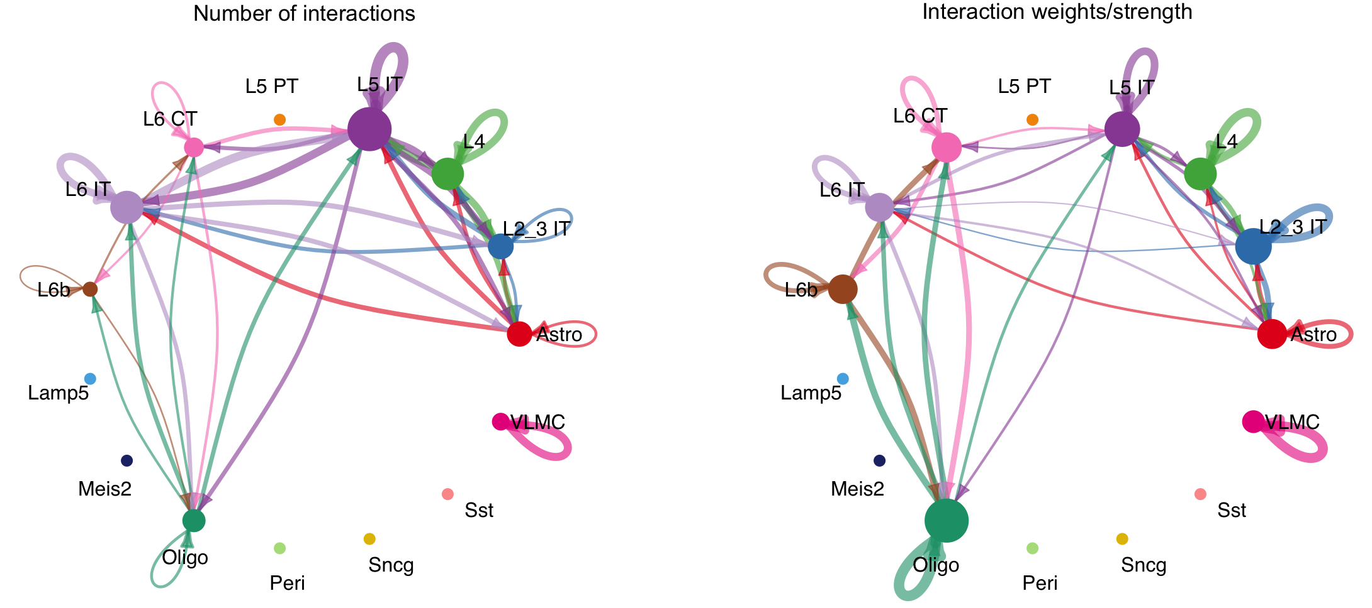
Visualization of the aggregated cell-cell communication network
Load dataset
Preprocessing
Inference of cell-cell communication network
Visualization network
par(mfrow = c(1,2), xpd=TRUE)
netVisual_circle(cellchat@net$count, vertex.weight = rowSums(cellchat@net$count),
weight.scale = T, label.edge = F, title.name = "Number of interactions")
netVisual_circle(cellchat@net$weight, vertex.weight = rowSums(cellchat@net$weight),
weight.scale = T, label.edge = F,
title.name = "Interaction weights/strength")

Slide 76
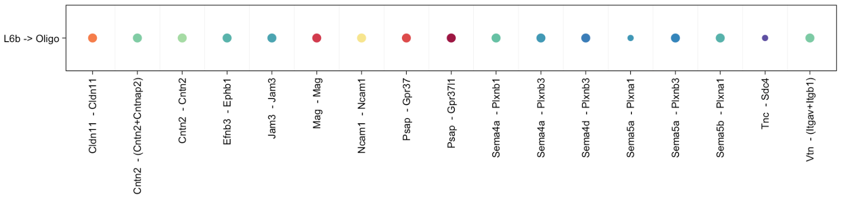
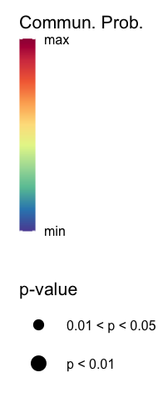
Identify ligand-receptor pairs between L6b and Oligo
Load dataset
Preprocessing
Inference of cell-cell communication network
Visualization network
CellChat::netVisual_bubble(cellchat, sources.use = c(8), targets.use = c(11),
remove.isolate = FALSE, angle.x = 90, thresh = 0.05) + coord_flip()
Levels | Labels
1 | Astro
2 | L2_3 IT
3 | L4
4 | L5 IT
5 | L5 PT
6 | L6 CT
7 | L6 IT
8 | L6b
9 | Lamp5
10 | Meis2
11 | Oligo
12 | Peri
13 | Sncg
14 | Sst
15 | VLMC
Psap – Gpr37l1

Slide 77
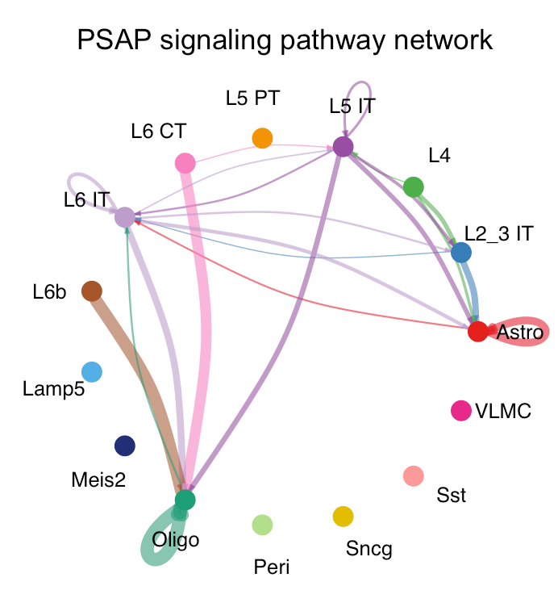
Inferred communication network of signaling pathways – Circle plot
Load dataset
Preprocessing
Inference of cell-cell communication network
Visualization network
pathways.show = c(”PSAP")
par(mfrow = c(1,1))
netVisual_aggregate(cellchat, signaling = pathways.show, layout = "circle")

Slide 78
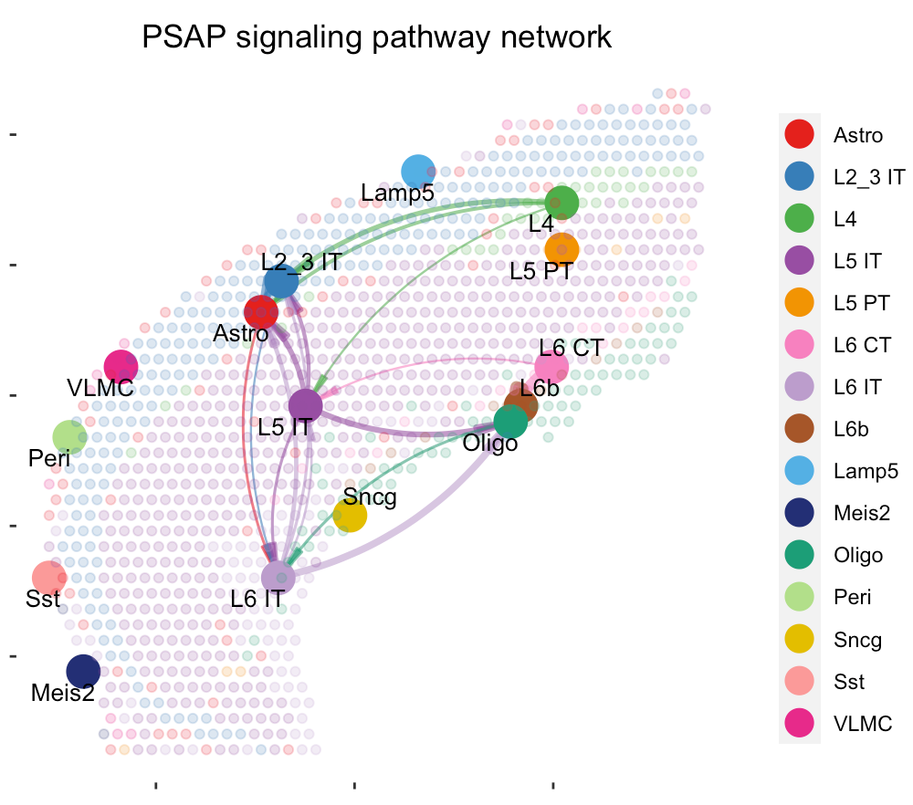
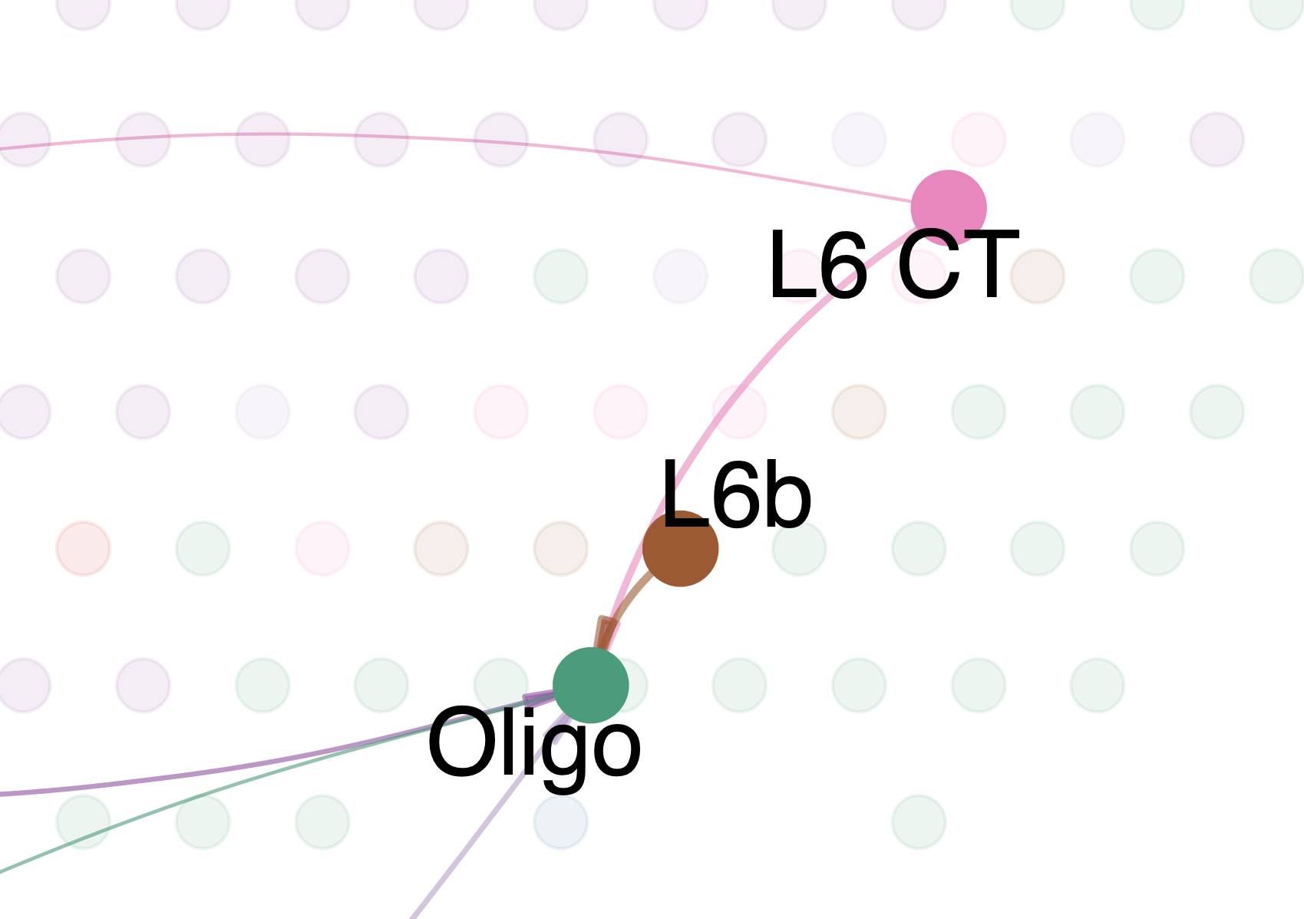
Inferred communication network of signaling pathways – Spatial plot
Load dataset
Preprocessing
Inference of cell-cell communication network
Visualization network
par(mfrow = c(1,1))
# Visualization information on the spatial imaging
netVisual_aggregate(cellchat, signaling = pathways.show, layout = "spatial", edge.width.max = 2, vertex.size.max = 1,
alpha.image = 0.2, vertex.label.cex = 3.5)

Slide 79
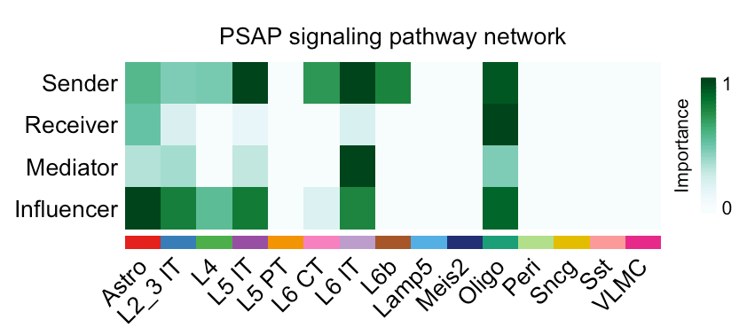
Compute the network centrality scores
Load dataset
Preprocessing
Inference of cell-cell communication network
Visualization network
# Compute the network centrality scores
cellchat = netAnalysis_computeCentrality(cellchat, slot.name = "netP")
# Visualize the centrality score
par(mfrow = c(1,1))
netAnalysis_signalingRole_network(cellchat, signaling = pathways.show,
width = 8, height = 2.5, font.size = 10)
Visualize the computed centrality scores using heatmap, allowing ready identification of major signaling roles of cell groups.

Slide 80
8
Visualization of multi-feature blended spatial plot - STUtility

Slide 81
Download dataset for STUtility
Download spaceranger output
Construct STUtility object
Blended Spatial Feature Plot
In Terminal
$ curl -O https://cf.10xgenomics.com/samples/spatial-exp/1.0.0/V1_Mouse_Brain_Sagittal_Anterior/V1_Mouse_Brain_Sagittal_Anterior_filtered_feature_bc_matrix.h5 # download
$ curl -O https://cf.10xgenomics.com/samples/spatial-exp/1.1.0/V1_Mouse_Brain_Sagittal_Anterior/V1_Mouse_Brain_Sagittal_Anterior_spatial.tar.gz
$ tar -xvzf V1_Mouse_Brain_Sagittal_Anterior_spatial.tar.gz

Slide 82
Construct STUtility object
Download spaceranger output
Construct STUtility object
Blended Spatial Feature Plot
# Set working directory to pre-downloaded directory (optional)
setwd(‘./KOGO_visium_STUtility_input_files/')
infoTable = data.frame(samples = c("./V1_Mouse_Brain_Sagittal_Anterior_filtered_feature_bc_matrix.h5"),
spotfiles = c("./spatial/tissue_positions_list.csv"),
imgs = c("./spatial/tissue_hires_image.png"),
json = c("./spatial/scalefactors_json.json"), stringsAsFactors = FALSE)
Mouse_Brain_STUtility = InputFromTable(infotable = infoTable, platform = "Visium")
# Function used to read HE images in jpeg or png format
Mouse_Brain_STUtility = LoadImages(Mouse_Brain_STUtility,
time.resolve = FALSE, verbose = TRUE)

Slide 83
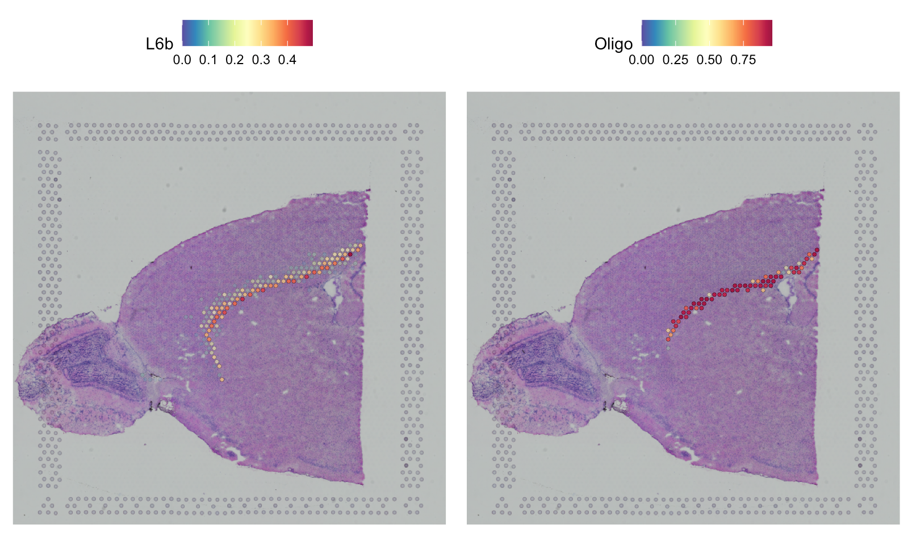
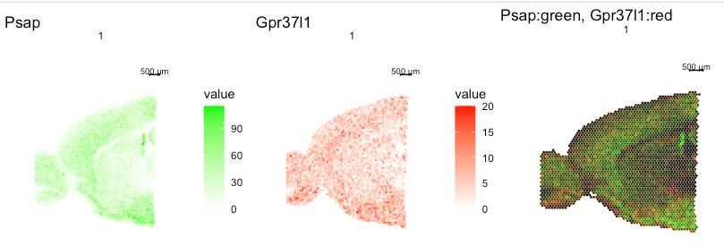
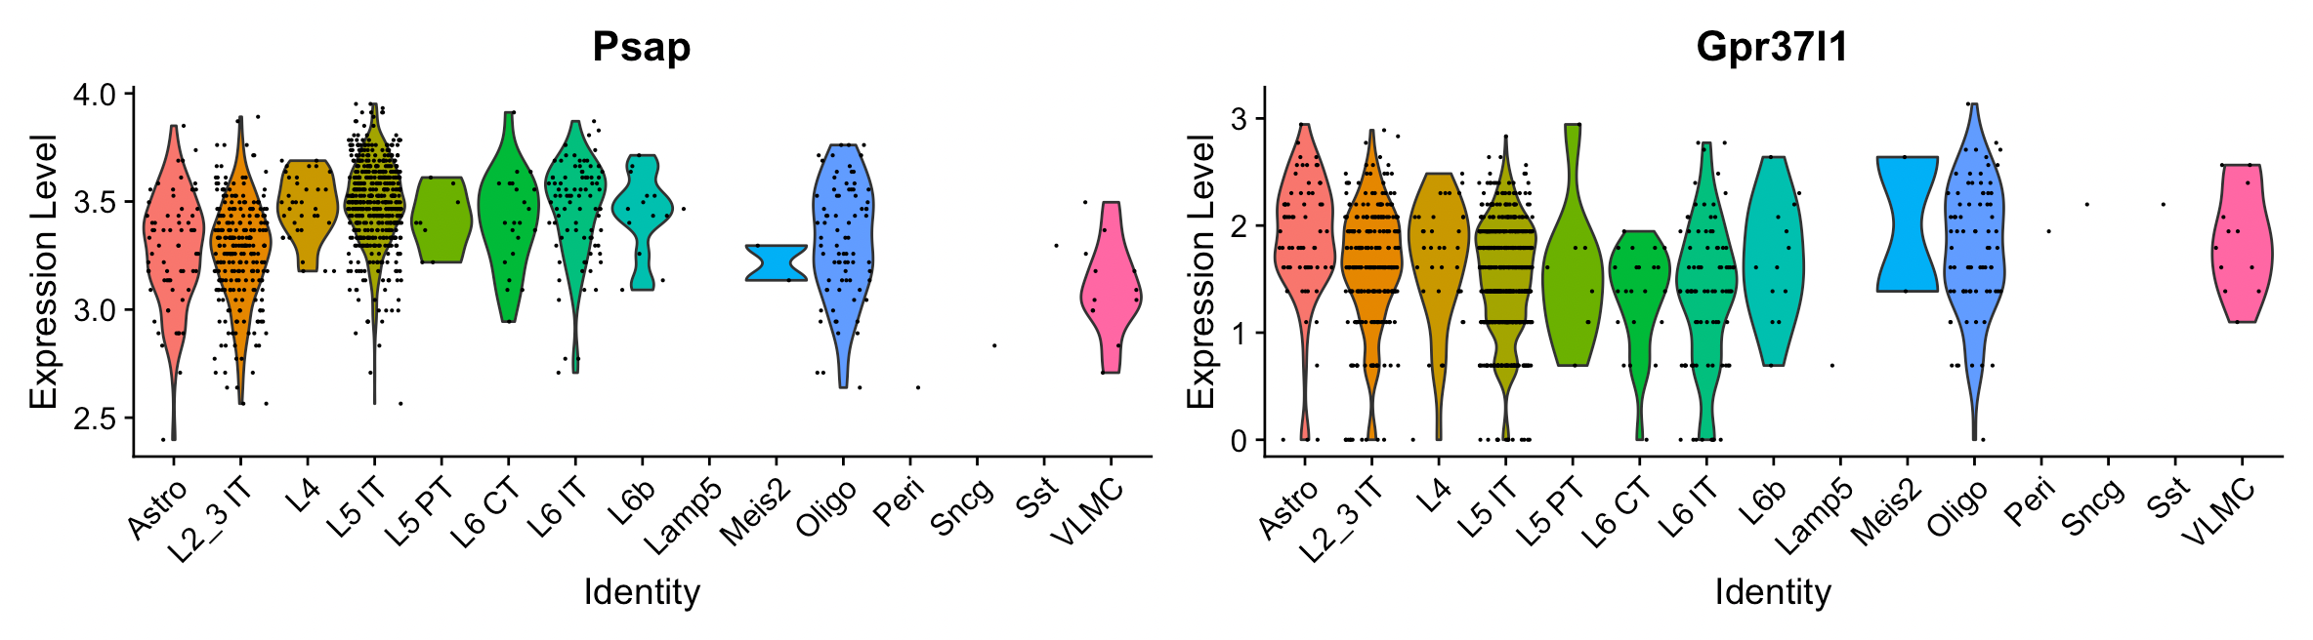
Ligand and Receptor Feature Plot
Download spaceranger output
Construct STUtility object
Blended Spatial Feature Plot
plot_grid(
ST.FeaturePlot(Mouse_Brain_STUtility, features = c("Psap"), cols = c("white","green")),
ST.FeaturePlot(Mouse_Brain_STUtility, features = c("Gpr37l1"), cols = c("white","red")),
ST.FeaturePlot(Mouse_Brain_STUtility, features = c("Psap","Gpr37l1"),
blend = TRUE, channels.use = c("green","red")), ncol = 3)
# saveRDS(Mouse_Brain_STUtility, "../KOGO_visium_cortex_STUtility.rds")

Slide 84
9
Summary

Slide 85
Summary
Load and preprocessing Visium
Load and preprocessing single cell
Find TransferAnchors
Transfer annotation
10X Genomics Visium sequence data & High-resolution microscope images of tissues
spaceranger count
Gene-Spot matrix
Seurat
Integrative analysis of spatial datasets
Seurat, SpaceXR
Deconvolution and Mapping Analysis
Squidpy
CellChat
Neighborhood analysis and co-occurrence
Cell-Cell interaction
STUtility
Visualization of blended spatial data

Slide 86
Reference
Load and preprocessing Visium
Load and preprocessing single cell
Find TransferAnchors
Transfer annotation
Space Ranger
Zheng, Grace X.Y., Terry, Jessica M., [...] Bielas, Jason H. (2017). Massively parallel digital transcriptional profiling of single cells. Nature Communications. 8: 1-12, doi:10.1038/ncomms14049
Seurat
Hao Y, Hao S, Andersen-Nissen E, III WMM, Zheng S, Butler A, Lee MJ, Wilk AJ, Darby C, Zagar M, Hoffman P, Stoeckius M, Papalexi E, Mimitou EP, Jain J, Srivastava A, Stuart T, Fleming LB, Yeung B, Rogers AJ, McElrath JM, Blish CA, Gottardo R, Smibert P, Satija R (2021). “Integrated analysis of multimodal single-cell data.” Cell. doi:10.1016/j.cell.2021.04.048, https://doi.org/10.1016/j.cell.2021.04.048
SpaceXR
Cable, Dylan M., et al. “Robust decomposition of cell type mixtures in spatial transcriptomics.” Nature Biotechnology 40.4 (2022): 517-526.
Squidpy
Palla, G., Spitzer, H., Klein, M. et al. Squidpy: a scalable framework for spatial omics analysis. Nat Methods 19, 171–178 (2022). https://doi.org/10.1038/s41592-021-01358-2
CellChat
Jin, S., Guerrero-Juarez, C.F., Zhang, L. et al. Inference and analysis of cell-cell communication using CellChat. Nat Commun 12, 1088 (2021). https://doi.org/10.1038/s41467-021-21246-9
STUtility
Bergenstråhle, J., Larsson, L. & Lundeberg, J. Seamless integration of image and molecular analysis for spatial transcriptomics workflows. BMC Genomics 21, 482 (2020). https://doi.org/10.1186/s12864-020-06832-3

Slide 87
10
Q&A

